Slide 1
FPF2188L EvB user guide

Slide 2
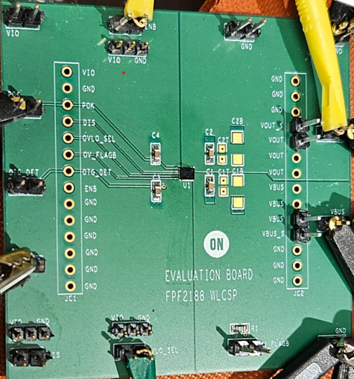
FPF2188L EvB user guide
For Sink mode test
  Apply VBUS and probe the Vout pin. Since ENB pin is internally pull-down, Vout will go high automatically.
  Check if BUS_DET goes high by the valid VBUS.
  Control ENB to low won’t make any differences.
  Add current load on VOUT and increase up to 6A.
  Turn off the switch by ENB pin to high and make DIS pin to high to see if VBUS discharge is enabled after turning off VBUS supply.
For source mode test
  When VBUS is off, enable BUS_DET and supply VOUT to high. And then see if VBUS goes high for OTG application. Add current load on VBUS up to 500mA
  While OTG mode is enabled, check if BUS_DET pin state, BUS_DET should be low while OTG_DET is high.
OVP test
  Select OV_SEL pin to high or low for OVP threshold. And then apply VBUS voltage, above than the OV threshold, and then see if OV_FLAGB pin to go low with the switch FET turn-off.

Slide 3

Surge test
  Prepare Equipment: Use the evaluation board (EvB) and a KT-200 surge tester.
    Powered Test: Use a coupler to keep the device powered during the surge.
    Unpowered Test: Apply the surge while the device is powered off—no coupler needed
  Pre-Test Check: Measure resistance between VBUS–GND and VOUT–GND to confirm the device is undamaged.
  Oscilloscope Setup: Connect the probe with an attenuator or resistor divider. Ensure the attenuated voltage stays within the probe’s maximum input rating.
  Initial Surge Test:
    Start with +150V (since 200V is the max spec for FPF2188L).
    Zap the device 3 times, then recheck resistance.
    If no change, repeat with –150V.
  Voltage Ramp-Up: Increase surge voltage in 10V increments up to 200V. Repeat the test on 3 separate devices.

