Slide 1
SiC MOSFETs: Gate Drive Optimization
Steve Mappus

Slide 2
Agenda
SiC Introduction
SiC MOSFET characteristics
SiC MOSFET dynamic switching
Discrete SiC gate drive circuit
NCP51705 SiC MOSFET gate driver
  Distinguishing features
  System performance
  Application circuit (EVB)
NCP51705 parametric test results
  Double pulse test
Closing Summary

Slide 3
SiC Introduction

Slide 4
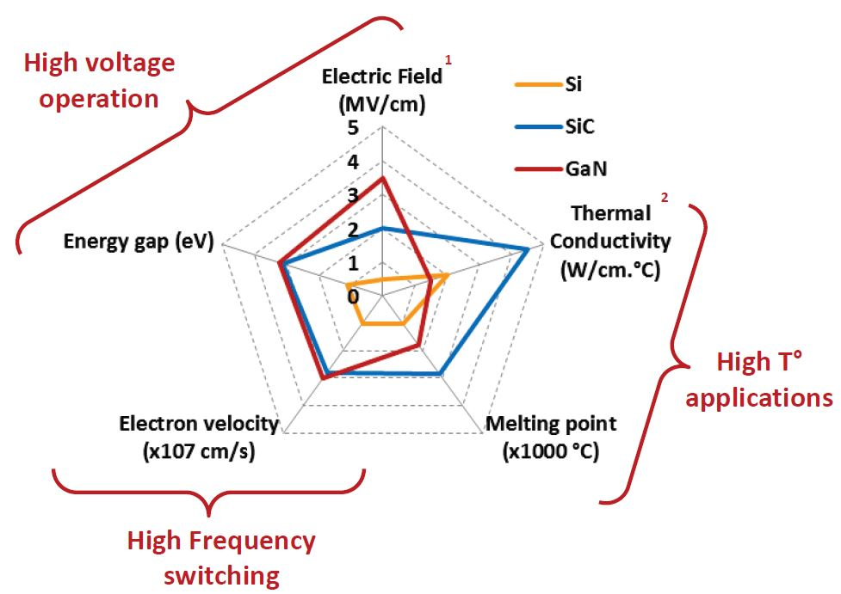
Si Verses WBG Material Properties
Properties | Si | 4H-SiC | GaN
Bandgap Energy (eV) | 1.12 | 3.26 | 3.50
Electron Mobility (cm²/Vs) | 1400 | 900 | 1250
Hole Mobility (cm²/Vs) | 600 | 100 | 200
Breakdown Field (MV/cm) | 0.3 | 2.0 | 3.5
Thermal Conductivity (W/cm°C) | 1.5 | 4.9 | 1.3
Maximum Junction Temperature (°C) | 150 | 600 | 400
Think SiC: High voltage, high frequency, very high temperature!

Slide 5
SiC MOSFET Characteristics
Most Critical for Gate Drive

Slide 6
SiC MOSFET: I_{D} vs V_{DS} Output Characteristics
Modest transconductance = low gain:
Require large V_{GS} to force large I_{D}:
Consider two I_{D} vs V_{DS} operating points, “A” and “B”:
SiC has no linear/saturation distinction
Behaves like voltage controlled resistor
Need over current protection (“DESAT”)
R_{DS} is 2.3 times higher for V_{GS}=12 V
SiC MOSFETs operate best at V_{GS}=20 V

Slide 7
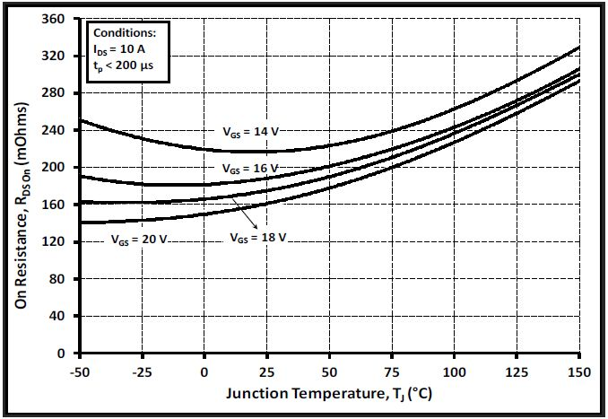
SiC MOSFET: On Resistance
PTC: Increase T_{J}=Increase R_{DS}
NTC: Increase T_{J}=Decrease R_{DS}
For Si MOSFET whenever V_{GS}>V_{TH}, R_{DS} has PTC
SiC has NTC for V_{GS}<16 V
  ΔR_{DS}/ΔT_{J} slope is negative
  Can not be easily paralleled for V_{GS}<16 V
R_{DS}≈R_{CH}+R_{DRIFT}+R_{J}
  R_{DRIFT}+R_{J} are PTC resistances
    Dominant at high V_{GS}
  R_{CH} is NTC resistance
    Dominant at low V_{GS}
Gate driver should be rated for VDD ≥ 25 V

Slide 8
SiC MOSFET: Internal Gate Resistance, R_{GI}
 | SiC_1 | SiC_2 | Si_1 SJ FET | Si_2 SJ FET
B_{VDSS} (V) | 1200 | 1200 | 900 | 650
I_{D} (A) | 19 | 22 | 36 | 15
R_{DS} (mΩ) | 160 | 160 | 120 | 130
Q_{G} (nC) | 34 | 62 | 270 | 35
Q_{GD} (nC) | 14 | 20 | 115 | 11
C_{ISS} (pF) | 525 | 1200 | 6800 | 1670
C_{OSS} (pF) | 47 | 45 | 330 | 26
V_{GS} (V) | -5 to 20 | -6 to 22 | ±20 | ±20
V_{GS(TH)} (V) | 2.5 | 2.8 | 3 | 3.5
R_{GI} (Ω) | 6.5 | 13.7 | 0.9 | 1
R_{GI}xC_{ISS} (ns) | 3.4 | 16.4 | 6.1 | 1.7
Relatively high R_{GI}
Much lower C_{ISS}
Slightly lower C_{GD} & C_{OSS}
R_{GI} is inversely proportional to die size
Smaller SiC die means higher R_{GI}
But….
  Lower Q_{G}
  Lower C_{iss}
  Lower R_{GI}xC_{iss} time constant
Gate driver output impedance should be as low as possible

Slide 9
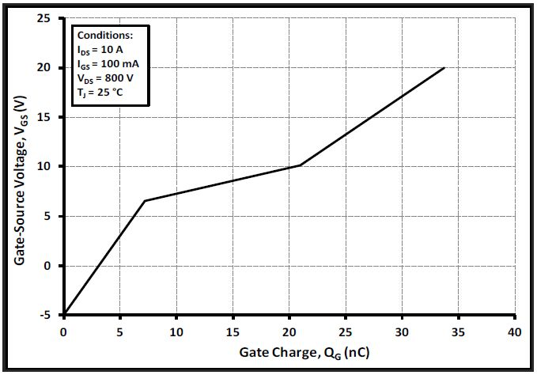
SiC MOSFET: Gate Charge
Gate charge loss limits operating frequency
Negative gate drive during off-time
  R_{GI} is high
  V_{GS}<0 V to ensure fast dV_{DS}/dt
  dV_{DS}/dt immunity against low V_{TH}
Miller plateau
  Higher V_{GS} compared to Si
  Not flat due to low g_{m}
Gate driver should be rated for -5 V<V_{GS(MIN)}<-2 V

Slide 10
SiC MOSFET Dynamic Switching

Slide 11
SiC MOSFET Switching: Turn-On
t0→t1: V_{GS}<V_{TH}, gate drive delay
t1→t2: V_{TH}<V_{GS}<V_{GS(MP)}, I_{D} is increasing
t2→t3: V_{GS}=V_{GS(MP)}, V_{DS} discharges
  Need high I_{G} during this interval
t3→t4: V_{GS}>V_{GS(MP)},
  R_{DS(ON)} reaches minimum value and has PTC
Gate driver should be rated for high I_{G} (I_{SRC}) at V_{GS(MP)}

Slide 12
SiC MOSFET Switching: Turn-Off
t0→t1: V_{DD}<V_{GS}<V_{TH(MP)}, R_{DS(ON)} increasing
t1→t2: V_{GS}=V_{GS(MP)}, V_{DS} increasing
t2→t3: V_{GS}=V_{GS(MP)}, I_{D} decreasing, body-diode blocking
t3→t4: V_{GS(MP)}<V_{GS}<V_{EE},
  R_{DS} reaches maximum value
  Need high I_{G} (I_{SNK}) during this interval
Gate driver should be rated for high I_{G} (I_{SNK}) at V_{EE}<V_{GS}<V_{GS(MP)}

Slide 13
SiC MOSFET Gate Driver Requirements
Summary of SiC gate drive requirements
  Able to withstand 35 V rail-to-rail (V_{DD}=25 V and V_{EE}=-10 V)
  V_{GS} must have fast rise and fall edges (~few ns)
  High I_{SRC} across the Miller plateau (several amps)
  Must have high I_{SNK} to guarantee hold off and high dV_{DS}/dt immunity
  V_{DD} UVLO level matched to SiC thermal capabilities
  DESAT function for monitoring over current across SiC MOSFET R_{DS(ON)}
  Low parasitic inductance package
  Small driver package able to be located close to SiC MOSFET

Slide 14
Discrete SiC Gate Drive Circuit

Slide 15
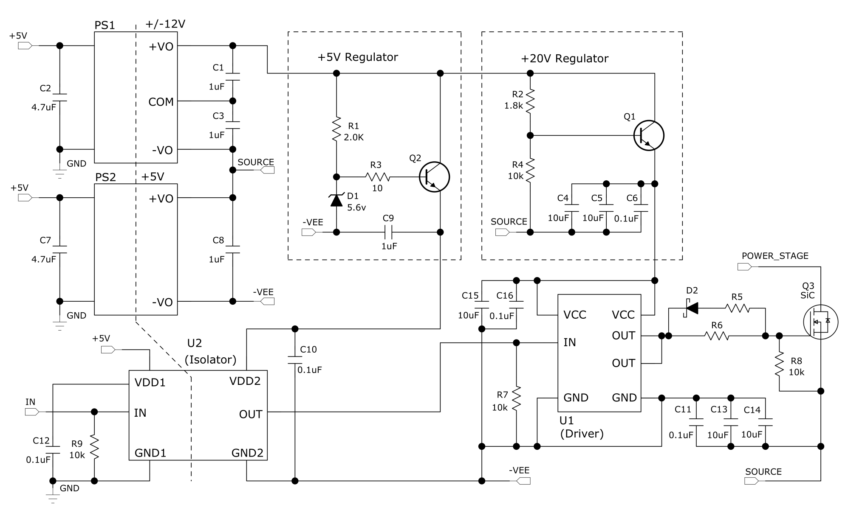
SiC “Discrete” Gate Drive Example
General purpose low-side gate driver
  V_{DD(MAX)}>25 V
Requires two dc-dc converters
  Post-regulation for isolator 5-V bias
  Low transformer winding capacitance. Example:
BUT…
  Limited driver choices
  No DESAT protection
  V_{DD} UVLO based on 12 V
  No V_{EE} UVLO

Slide 16
Integrated SiC Gate Drive Circuit

Slide 17
NCP51705 SiC Gate Driver
Features
  V_{DD} rated for 28 V
  I_{SRC}=6 A, I_{SNK}=10 A at ~V_{DD}/2
  5 V, 20 mA bias regulator
  Separate signal, power ground
  Separate OUTSRC, OUTSNK
  Internal thermal shutdown
  Separate IN+, IN- TTL inputs
“Differentiating” Features
  DESAT, OCP
  Internal V_{EE} charge pump
  Programmable V_{DD} UVLO
  XEN, fault and driver “status”
  4 mm x 4 mm MLP

Slide 18
NCP51705 DESAT
DESAT is in addition to PWM OCP
Protects SiC MOSFET against excessive power dissipation
  R_{DS}↑, V_{DS}↑ while I_{D} is maximum
  V_{DD} or V_{GS} too low
  Short-circuit or overload
Monitors V_{DS} only during on-time
  500ns timer allows V_{DS} time to fall
Programmable by R₁, D₁ selection
Select D₁ with lowest C_{J}

Slide 19
NCP51705 V_{EE} Charge Pump, VEESET
390 kHz fixed frequency (290 kHz option)
Three small SMD ceramic capacitors
V_{EE} UVLO ~80 % set value
V_{EE} programmable by VEESET
  VEESET=GND, V_{EE} UVLO is disabled
VEESET | COMMENT | V_{EE} | V_{EE(UVLO)}
V_{DD} | 9 V<VEESET<V_{DD} | -8 V | -6.4 V
V5V |  | -5 V | -4 V
OPEN | Add C_{VEE}≤100 pF from VEESET to SGND | -3 V | -2.4 V
GND | Remove C_{VEE} and connect V_{EE} to PGND | 0 V | NA
GND | Connect V_{EE} to external negative voltage rail | -V_{EXT} | NA

Slide 20
NCP51705 UVSET
Active at V_{DD}=7 V
Fixed 1 V, V_{DD} UVLO hysteresis
  V_{OFF}=V_{ON}-1 V
Two UVLO conditions to enable OUT
  V_{DD}>V_{ON}
  V_{EE}<80 % set value
  R_{UVSET} chosen for desired V_{ON} by:

Slide 21
NCP51705 UVSET, HV Start-Up Considerations
Set V_{ON}=17 V, shallow C_{VCC} discharge ramp:
Set V_{ON}=12 V, deep C_{VCC} discharge ramp:
Large C_{VCC}, high V_{GS} start on SiC
Small C_{VCC}, low V_{GS} start on SiC

Slide 22
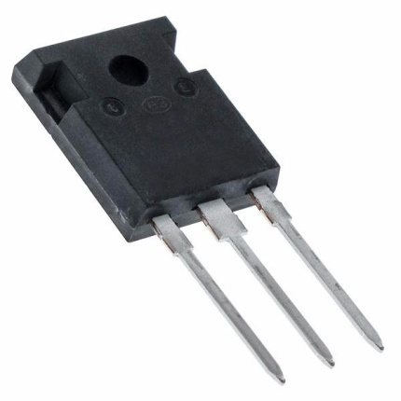
NCP51705 Package
4 mm x 4 mm MLP
  Low inductance
  Double pins, double bond for power connections
  digital on left side for easy PWM interface
  Bottom pad is electrically isolated, thermally conductive; heatsink to PCB (do not connect to PGND or SGND)
Power dissipation concerns
  Disable internal charge pump, use external V_{EE}
  No load on V5V (5 V)
  Lower switching frequency
  Get creative with top side heatsinking
SiC MOSFETs mostly stuck in TO-247 packages

Slide 23
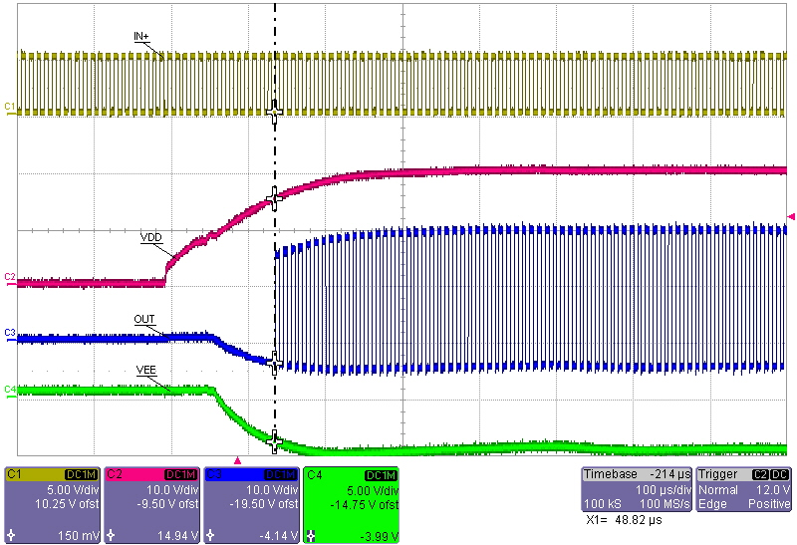
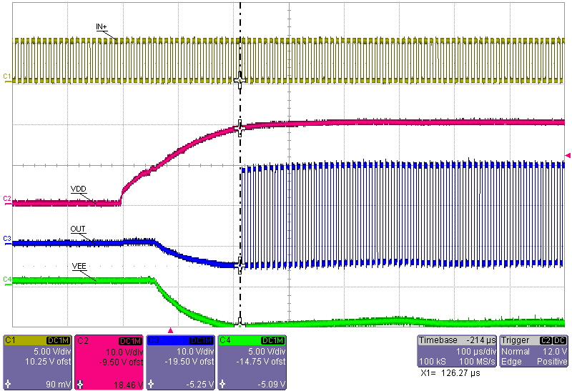
NCP51705 Start Up
V_{DD_UVLO(ON)}=12 V
  V_{DD}=14.94 V, V_{EE}=-4 V (80 % of -5 V)
  V_{EE} UVLO Dominates
V_{DD_UVLO(ON)}=18 V
  V_{DD}=18.45 V (VEESET point), V_{EE}=-5 V
  V_{DD} UVLO Dominates

Slide 24
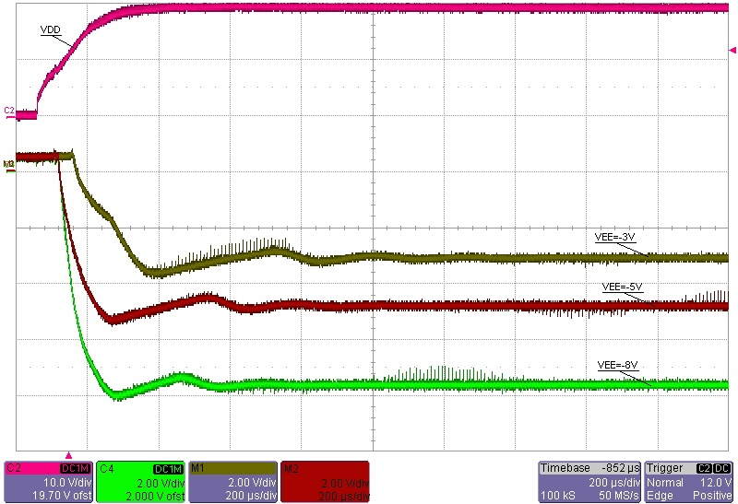
NCP51705 V_{EE} Start Up
V_{EE} slow control loop
  Slight undershoot
  ~400 µs correction
  Regulates to -3 V, -5 V or -8 V by VEESET pin strapping
VEESET | COMMENT | V_{EE} | V_{EE(UVLO)}
V_{DD} | 9 V<VEESET<V_{DD} | -8 V | -6.4 V
V5V |  | -5 V | -4 V
OPEN | Add C_{VEE}≤100 pF from VEESET to SGND | -3 V | -2.4 V
GND | Remove C_{VEE} and connect VEE to PGND | 0 V | NA
GND | Connect VEE to external negative voltage rail | -V_{EXT} | NA

Slide 25
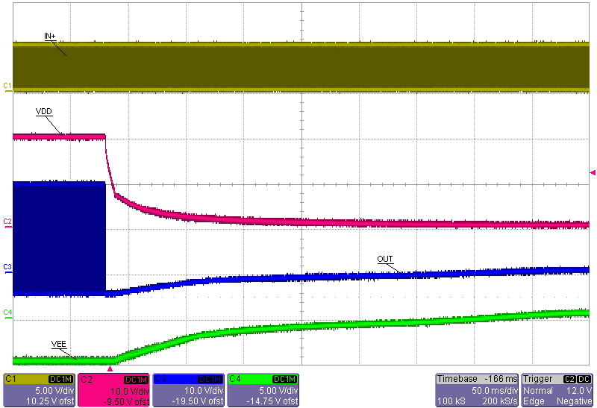
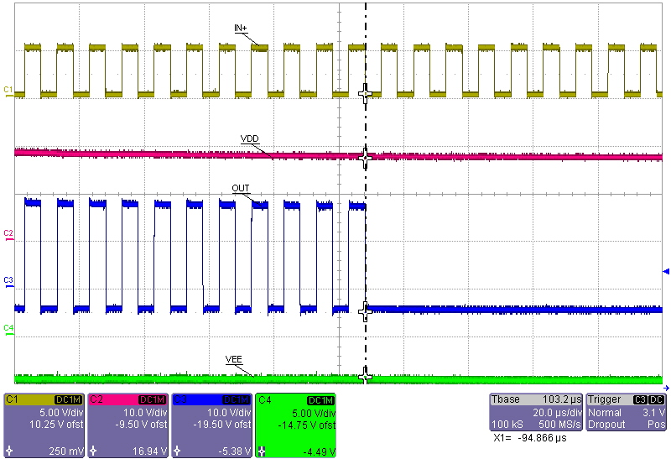
NCP51705 Shut Down
Smooth shutdown, no glitch pulses
  OUT stops switching, tracks V_{EE} discharge
V_{DD_UVLO(ON)}=18 V
  V_{DD}=17 V off (18 V-1 V hysteresis)
  OUT pulse terminates when V_{DD}<17 V

Slide 26
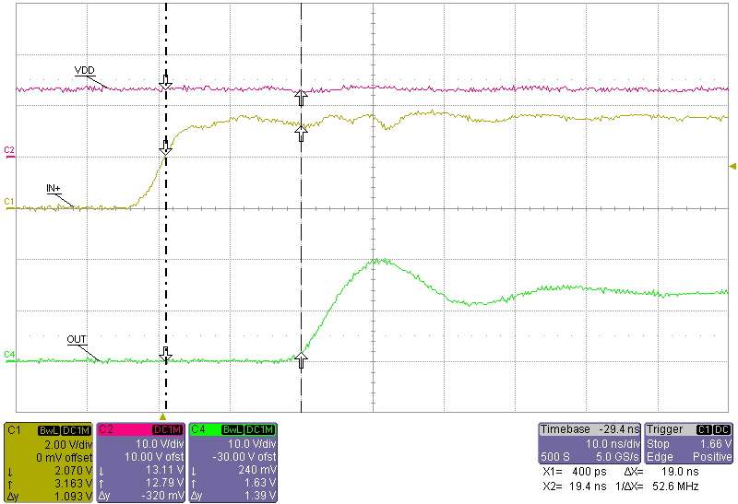
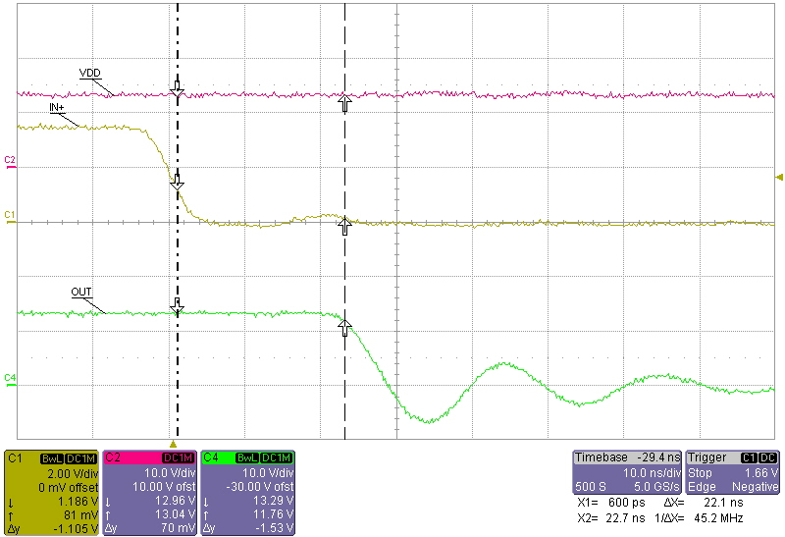
NCP51705 Propagation Delay
Turn-on, VDD=12 V, C_{OUT}=1 nF
  19 ns, 90 % IN+ to 10% OUT
  t_{RISE}≈5 ns
Turn-off, VDD=12 V, C_{OUT}=1 nF
  22 ns, 10% IN+ to 90% OUT
  t_{FALL}≈5 ns

Slide 27
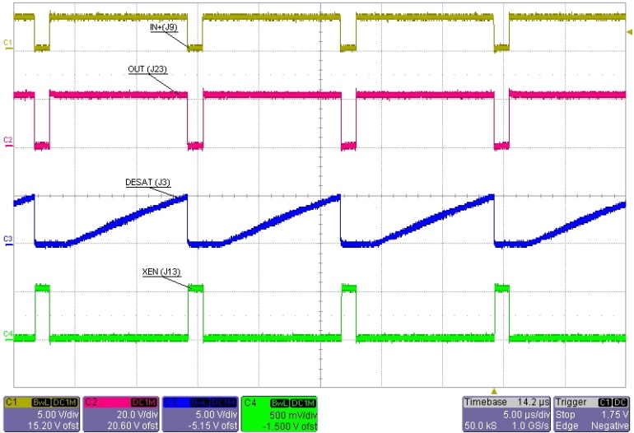
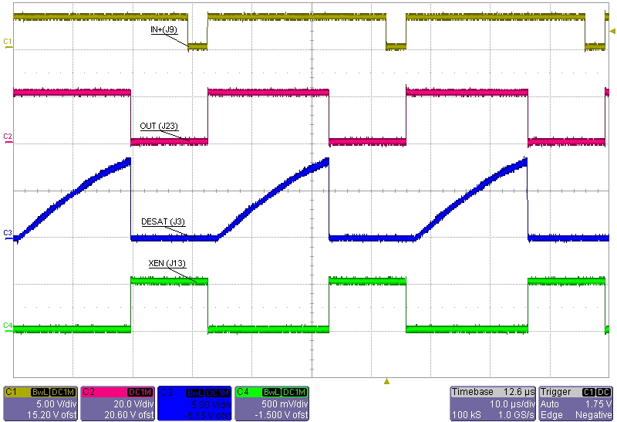
NCP51705 DESAT
Normal operation, 80 kHz, 100 pF
  V_{DESAT}=5 V (<7.5 V threshold)
Fault operation, 30 kHz, 100 pF
  V_{DESAT}=7.5 V
  OUT trailing edge terminated

Slide 28
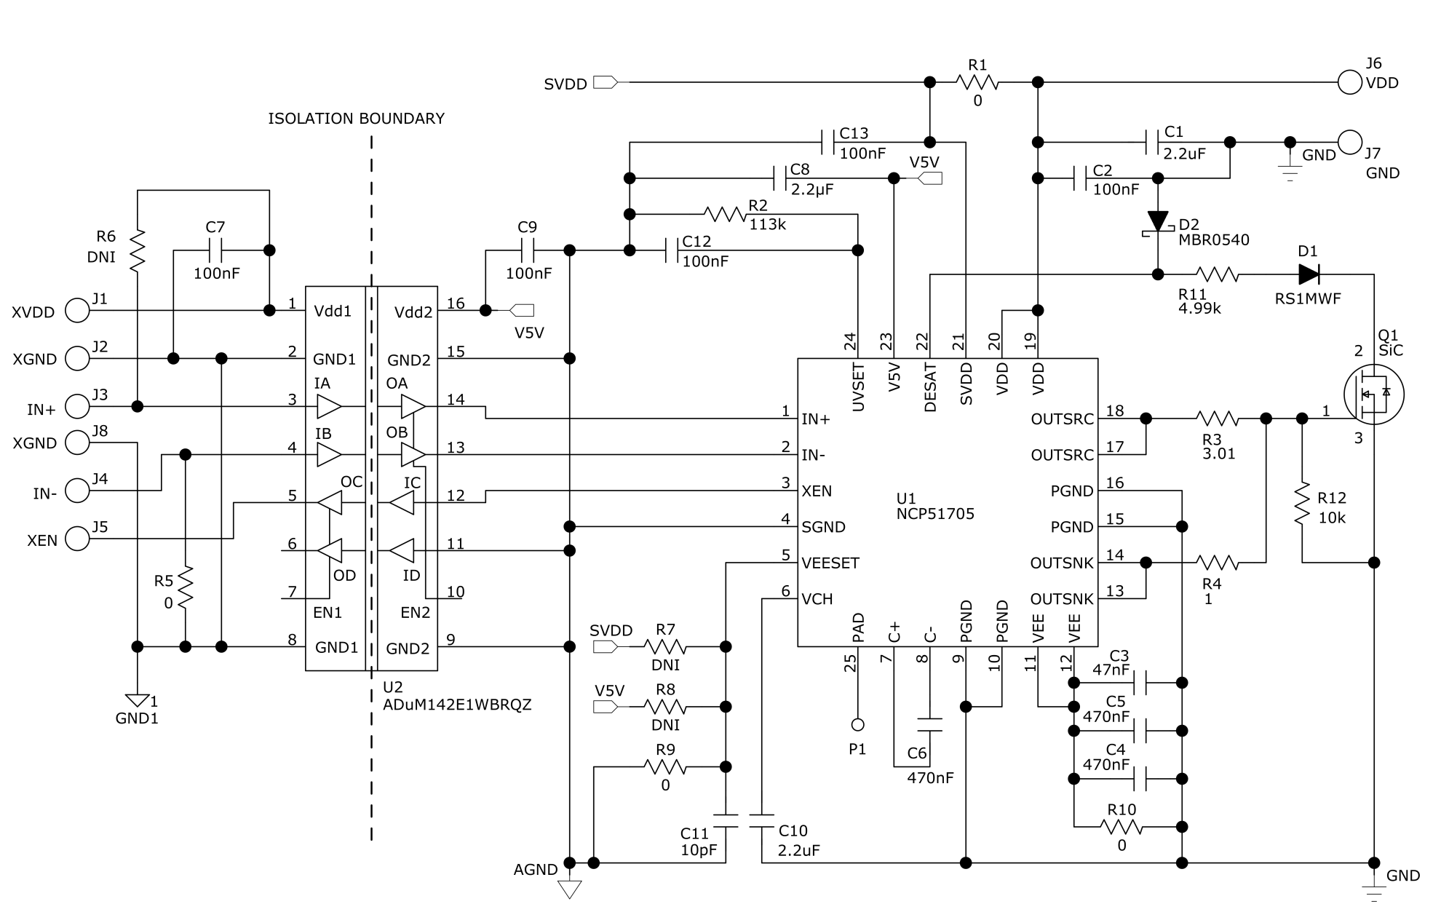
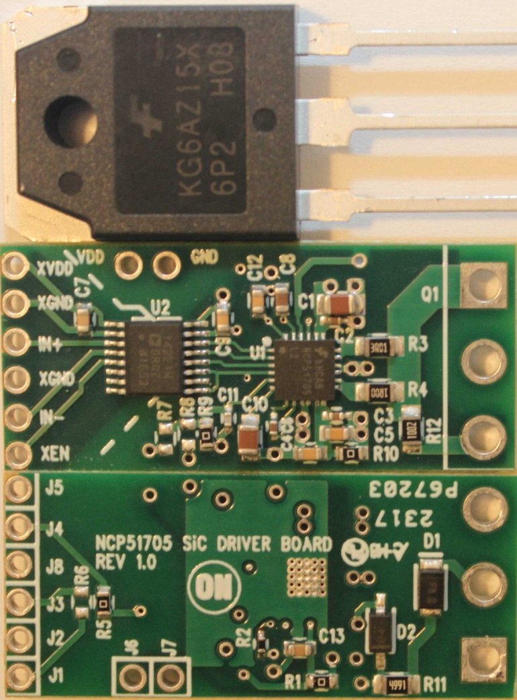
NCP51705 Mini EVB
35 mm x 15 mm, TO-247

Slide 29
NCP51705 Mini EVB
Mounting into existing power PCB
Hardwire to EVB
  XVDD/XGND (digital isolator primary +5 V)
  V_{DD}/GND (NCP51705 +20 V)
  IN+/XGND (PWM input signal)
Option 1 (preferred) - Horizontal mounting
Option 2 – Vertical mounting

Slide 30
Parametric Test Results

Slide 31
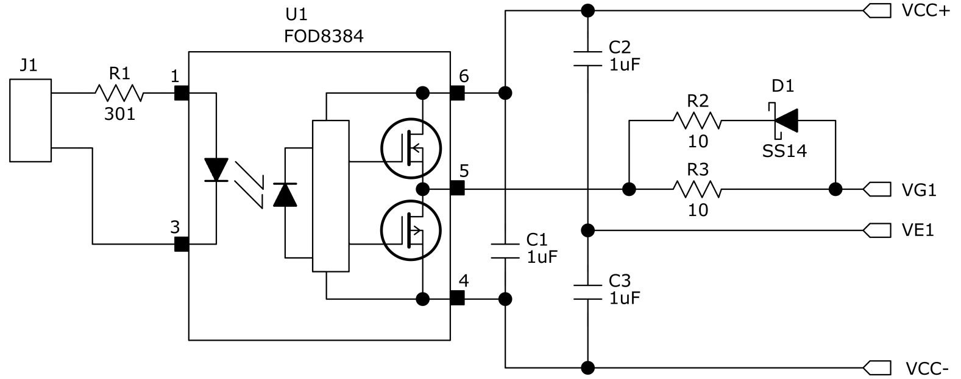
Double Pulse Test
Clamped inductive switching
Compare switching performance between NCP51705 mini EVB and basic SiC opto-coupler driver

Slide 32
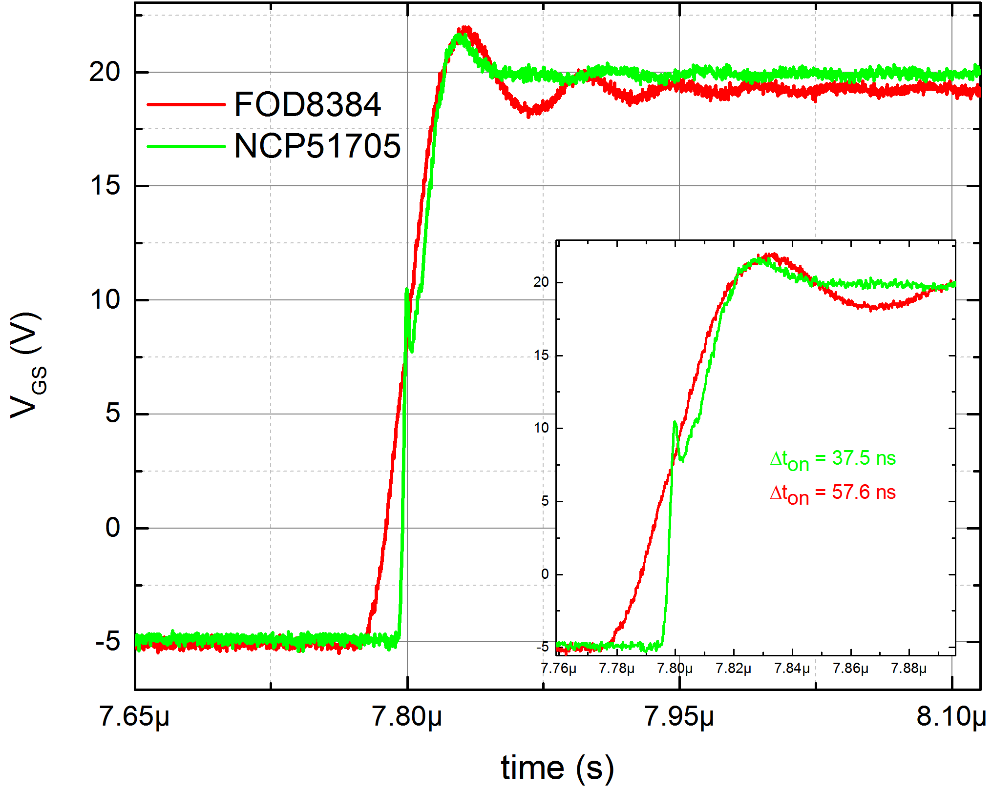
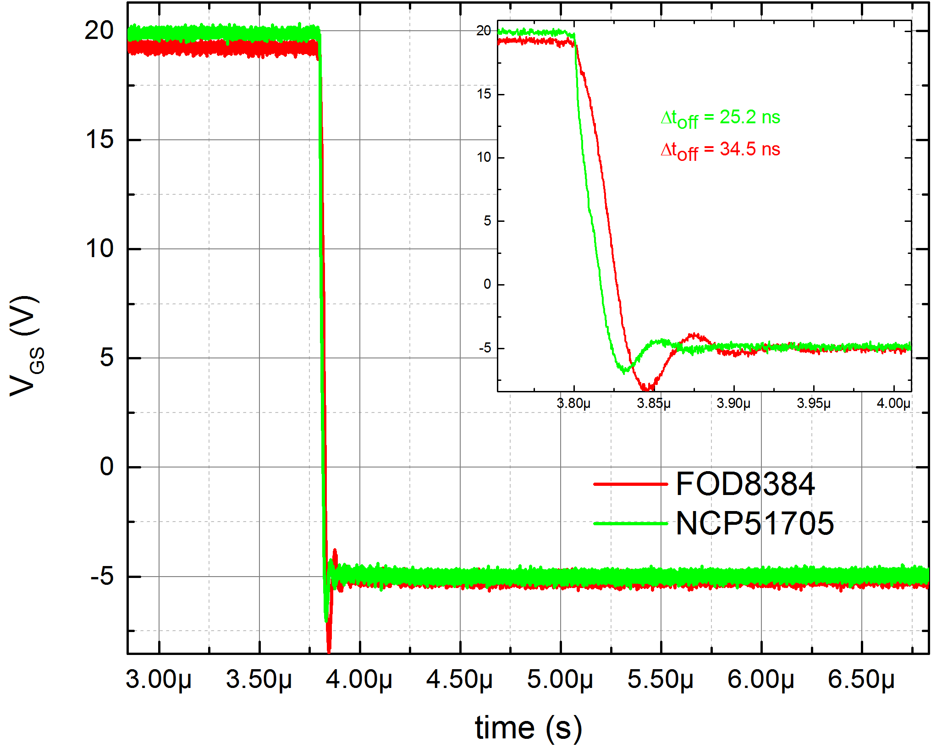
V_{GS} Dynamic Switching
V_{GS} rising
  1.2 kV SiC MOSFET load
  V_{DS}=600 V, I_{D}=30 A, -5 V<V_{GS}<20 V
V_{GS} falling
  1.2 kV SiC MOSFET load
  V_{DS}=600 V, I_{D}=30 A, -5 V<V_{GS}<20 V

Slide 33
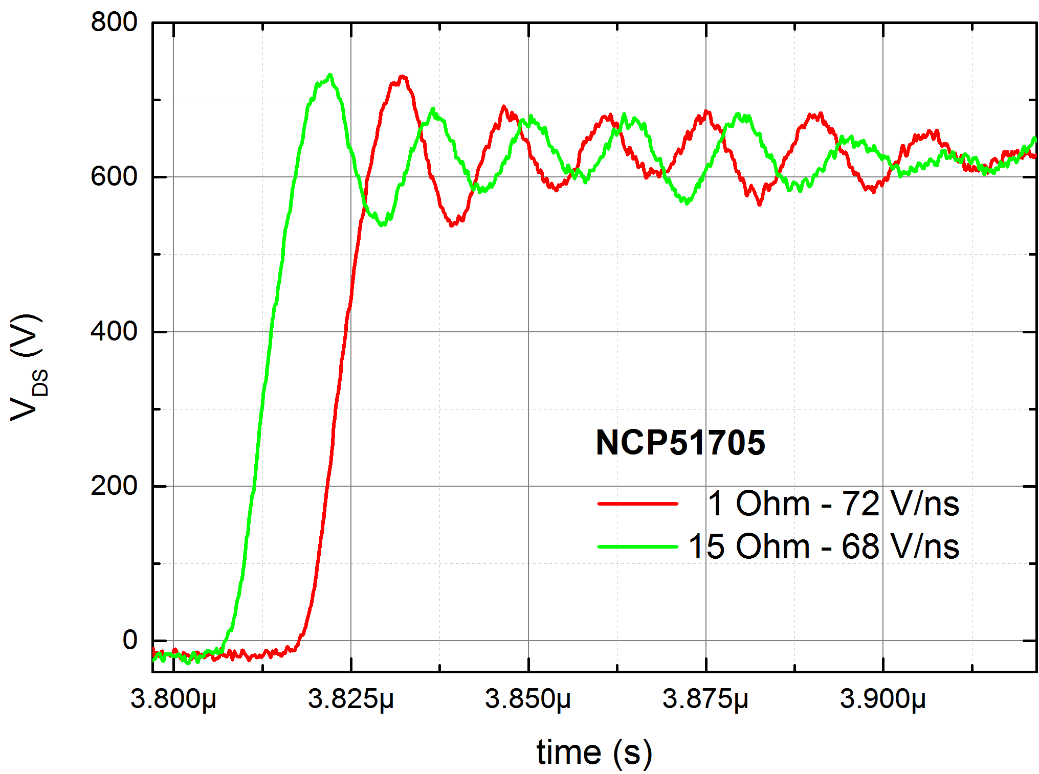
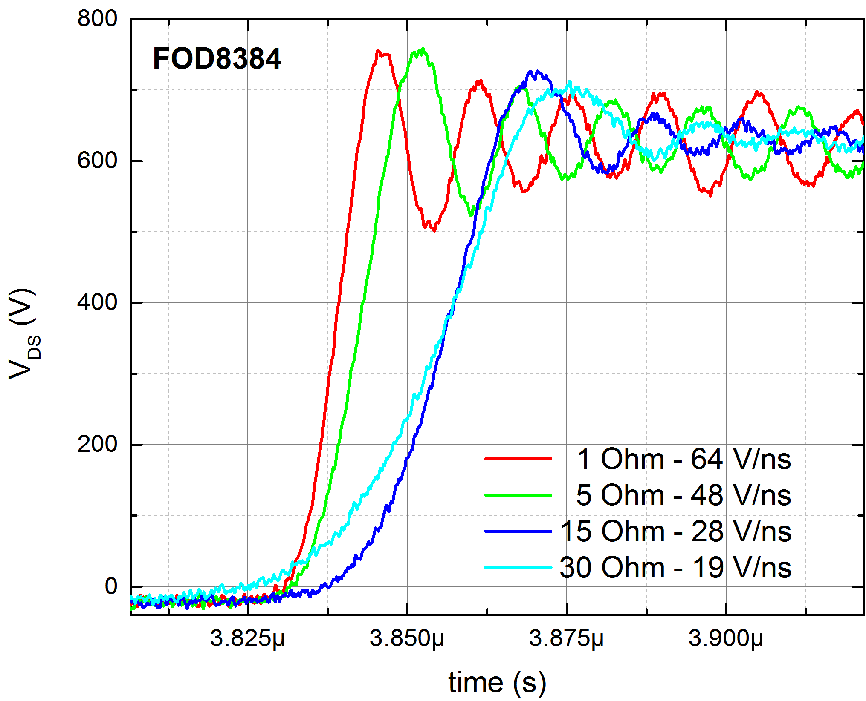
V_{DS} Dynamic Switching, Vary R_{GATE}
NCP51705 V_{DS} rising
  V_{DS}=600 V, I_{D}=30 A, -5 V<V_{GS}<20 V
  1.1:1 dV_{DS}/dt variation for 1 Ω<R_{GATE}>15 Ω
FOD8384 V_{DS} rising
  V_{DS}=600 V, I_{D}=30 A, -5 V<V_{GS}<20 V
  2.3:1 dV_{DS}/dt variation for 1 Ω<R_{GATE}>15 Ω

Slide 34
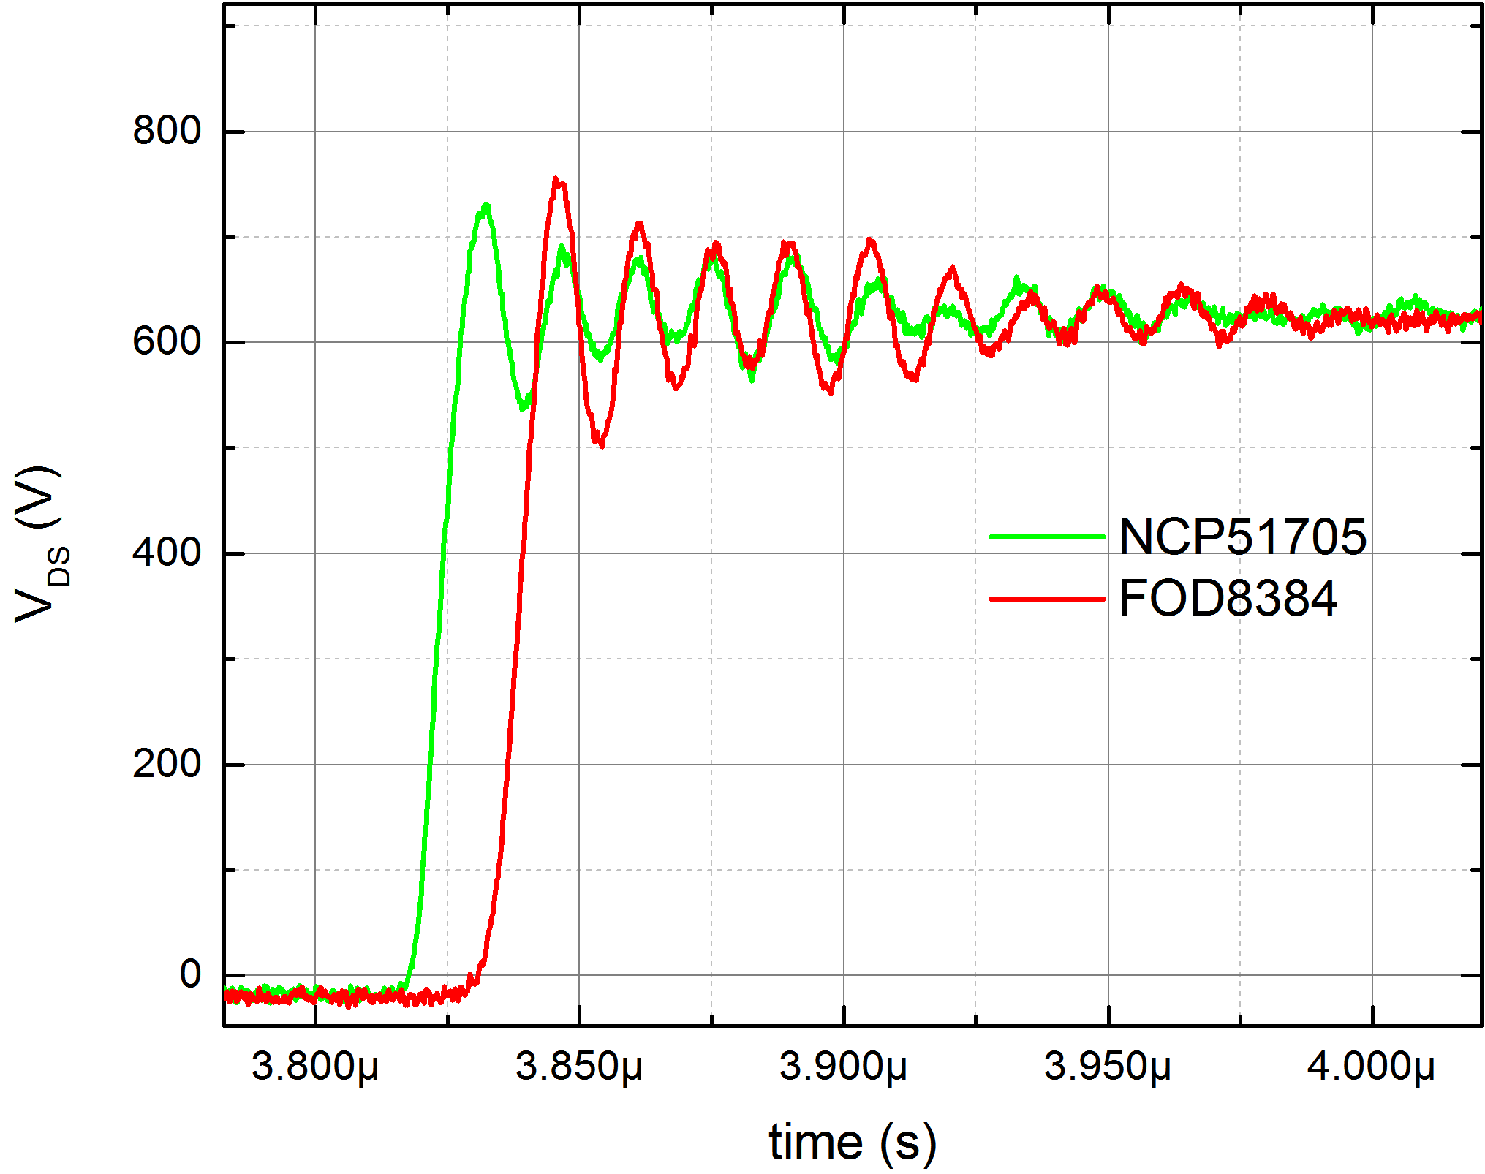
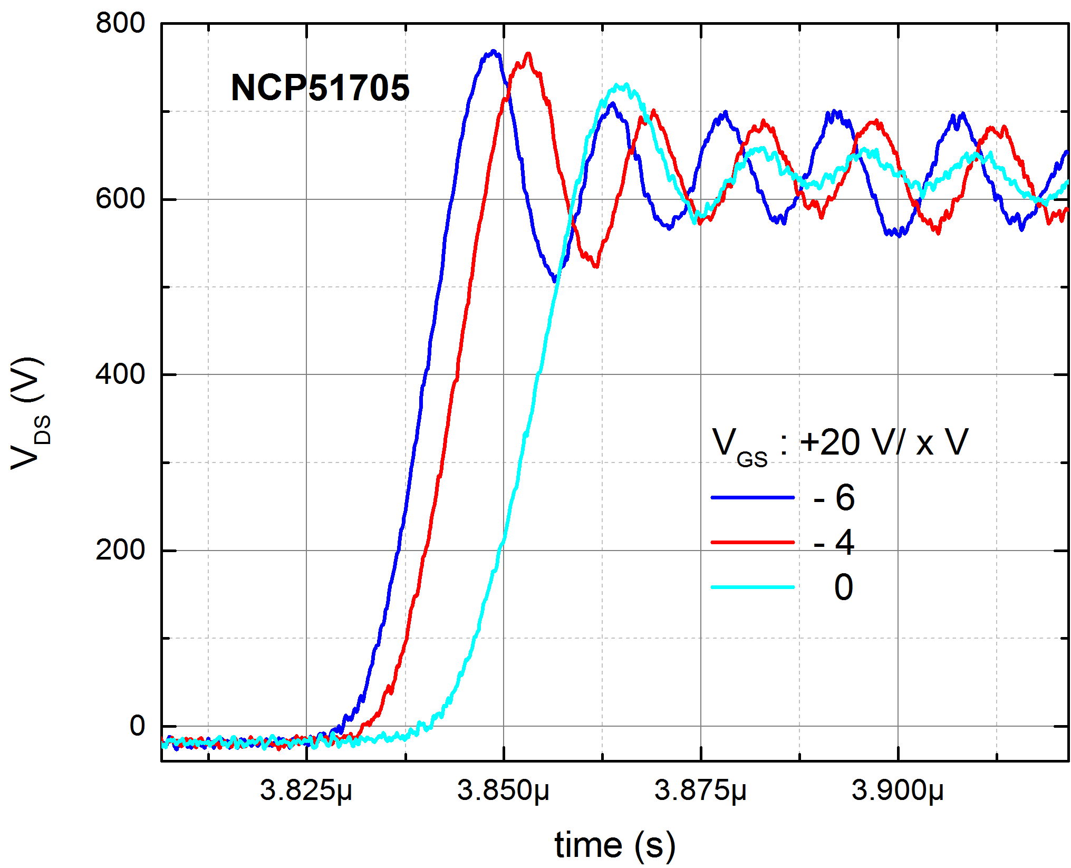
V_{DS} Dynamic Switching
NCP51705 vs FOD8384 compare
  V_{DS}=600 V, I_{D}=30 A, -5 V<V_{GS}<20 V, R_{GATE}=1 Ω
  NCP51705, faster dV/dt, better damping, less ringing
NCP51705 V_{DS} rising, -6 V<V_{EE}<0 V
  V_{DS}=600 V, I_{D}=30 A

Slide 35
Closing Summary
Gate drive: Most critical but often overlooked
Simple, reliable, high performance gate drive is critical
for SiC success
NCP5170
  Simple
  Flexible
  High-speed
  Minimal components
  Reliable

