Slide 1



Control Loop Design and Easy Verification Method
Didier Balocco
Public Information © onsemi 2022

Slide 2
Introduction
The objective of this paper is to demystify loop simulations and loop measurements.
A simple method will be introduced and it can be applied to any loop with analog or digital control.
This method will use very simple equipment.
This paper will not cover simulation models creation but only how to use them.

Slide 3
Content
Introduction (Done).
Loop Theory and Stability Criteria.
Characterization.
Simulations.
Measurement Method.
Loop Optimization.
Conclusion.

Slide 4
Loop Theory and Stability Criteria
(Very brief and simple)
Public Information © onsemi 2022

Slide 5
Loop Theory: System Block Diagram
Any loop can be modeled as:
Reference
Error
C
Drive
H
Output
Measurement | K
Where H is the Plant to control, K the measurement divider and C the compensator

Slide 6
Loop Theory: System Equations
Reference
Error
C
Drive
H
Output
We can write the following equations:
Measurement
K
⎧⎪ Error = Reference − K ⋅Output
⎨
⎪⎩ Output = C⋅ H ⋅ Error
Solving those equations gives:
Output = ^{H ⋅C} Reference
1+ H ⋅ K ⋅C

Slide 7
Loop Theory: System Equations
Reference
Error
C
Drive
H
Output
Normally, in the compensator C, we place an integrator. In this case, the static gain (or dc gain) is infinite. Thus:
Measurement
K
Lim C(ω) = ∞
ω→0
In dc, we get the output equation equal to :
Output = ¹ Reference
K

Slide 8
Loop Theory: System Equations
Reference
Error
C
Drive
H
Output
We can derive the Measurement versus Error, we get:
Measurement
K
Measurement = H ⋅ K ⋅C⋅ Error
We can derive the Measurement versus Reference, we get:
H ⋅ K ⋅C
Measurement = Reference 1+ H ⋅ K ⋅C

Slide 9
Loop Theory: System Equations
Reference
Error
C
Drive
H
Output
I will define the following terms:
Measurement
K
H ⋅ K ⋅C
S =
1+ H ⋅ K ⋅C
− Closed-loop equation :
T = H ⋅ K ⋅C
− Open-loop equation :
We have the following relations:
S
T
T =
and
S =
1−S
1+ T

Slide 10
Loop Theory: Stability Criteria
Reference
Error
C
Drive
H
Output
Measurement
K
The closed-loop is unstable if the denominator equals zero.
1+ H ⋅ K ⋅C = 0 ⇔ H ⋅ K ⋅C = −1
When it happens,
  The system oscillates or saturates.

Slide 11
Loop Theory: Stability Criteria
Nyquist was the first to work on system stability analysis and loops.
He defined the first stability criteria:
− In the imaginary plan, moving on the open-loop curve from a low frequency f₁ to a high frequency f₂, to ensure stability, we should pass around the -1 and leave the -1 point on the left-hand side.
− If it is on the right-hand side, the system is unstable.

Slide 12









Loop Theory: Stability Criteria
Stable system curve:
Unstable system curve:
f1<f2
f2
f1<f2
f2
Real Axis
-1
f1
-1
Real Axis
Imaginary
Axis
Imaginary
Axis
f1

Slide 13
Loop Theory: Margins Definitions
Phase Margin:
− Phase difference between the crossover point (at 0 dB) of the open-loop transfer function magnitude and -180°.
The crossover point should be single.
Gain Margin :
− Opposite of the gain when the transfer function phase is equal to -180°.

Slide 14









Loop Theory: Margins definitions
Margins in Nyquist: • Margins in Bode:
Gain
Gain Margin
f1<f2
f1
Gain Margin
Phase Margin
-1
f2
f
Real Axis
f2
Imaginary
Axis
Phase
f1
-180°
f
Phase Margin

Slide 15





Loop Theory: Margins definitions
In Black-Nichols:
− Vertical axis is the Gain,
− Horizontal axis is the Phase.
-180°
f1
Gain
Margins are easy to measure:
− Horizontally for the Phase,
− Vertically for the Gain.
-1
Phase Margin
Phase
f2
Gain Margin

Slide 16
Loop Theory: Black-Nichols Advantages
Black-Nichols diagrams are very useful when gain varies (e.g. with an optocoupler in the return path).
In this case, the curve shifts up or down.
So when the gain changes, it is very easy to evaluate how much phase margin will remain.

Slide 17







Loop Theory: Black-Nichols Advantages
-180°
CTR Max
Min
Gain
You may need to select a different CTR optocoupler when you measure open-loop curves and display them in a Black-Nichols diagram.
CTR Average
Phase
Margin
-1
Max Phase Margin
Phase
Min Gain Margin
CTR Min
Max Gain Margin

Slide 18
Characterization
How to obtain the plant or system transfer function ?
Public Information © onsemi 2022

Slide 19
Characterization: Principle
When we don’t have the Plant equation:
− We can simulate or measure it.
The obvious way is to work with the system in open-loop.
Problems (mainly when measuring a real system):
− The transfer function depends on the operating point.
− Any noise (or self-heating) during measurement can change it…
  The system can saturate and not behave in linear region.

Slide 20
Characterization: Principle
We will simulate or measure the system in closed-loop to have the operating point automatically set by the loop.
We need a way to open the loop to obtain the transfer function…by simulation or measurement.
− We need a kind of mux to maintain the loop around its dc operating point and inject the ac measurement/simulation signal.
  We can use a simple adder.

Slide 21
Characterization: Principle
The system to characterize + the adder can be modeled with the following block diagram:
Reference Error
C
Drive
H
Output
ε
Addition
Return =
K
Measurement
− Where χ is the injected or added ac signal to the loop.

Slide 22
Characterization: Principle
Reference
Error
C
Drive
H
Output
ε
Addition
The measurement system equations are:
Return =
K
Measurement
⎧ Error = Reference − Addition
⎪
Drive = C⋅ Error
⎪
⎨ Output = H ⋅ Drive
⎪ Return = K ⋅Output
⎪
⎪⎩ Addition = ε+ Return
After solving, we get:
Output = ^{H ⋅C} Reference − ^{H ⋅C} ε
1+ H ⋅ K ⋅C 1+ H ⋅ K ⋅C

Slide 23
Loop Measurement System Equations
Reference
Error
C
Drive
H
Output
ε
Addition
Considering ac signals only in previous system,
Return =
K
we can obtain the following equations around the adder:
Return ₌ −H ⋅ K ⋅C
Measurement
►
ε
“− Closed-Loop”
1+ H ⋅ K ⋅C
^{Return} = −H ⋅ K ⋅C Addition
►
“− Open-Loop”
It is almost what we are looking for…Open- or Closed-Loop.

Slide 24
Characterization: Discussion
In theory, in this block diagram, the injection point has no influence on the loop being measured or simulation.
− It can be placed anywhere in the loop.
There are 3 ways to make a Mux/Adder to inject Ε in the loop :
Addition
Addition
Addition
Return
ε
ε
ε
Return
Return

Slide 25
Characterization: Discussion
First solution :
− For simulation: a simple voltage source
− For measurement: using a transformer for galvanic isolation.
Second solution :
− It is the same principle like in RF,
when power and RF use the same coaxial cable.
Addition
ε
Return
− For simulation only: as the crossover frequency is lower than in RF,
we can use a 1-kF capacitor and 1-kH inductor to have enough bandwidth and separate DC and AC signals.
Addition
ε
Return

Slide 26
Characterization: Discussion
Third solution :
− For simulation: adder are available in libraries
− For measurement: using an adder with unity gain made with an operational amplifier and resistors.
Addition
Return
ε

Slide 27
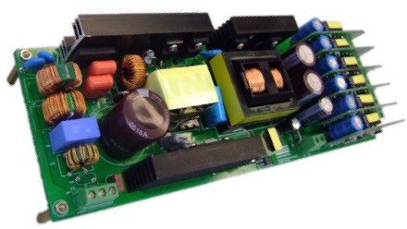
Characterization : Discussion
Output
Addition
Return
ε

Slide 28
Characterization: Practical Measurement Aspects
We need to inject the signal WITHOUT “changing” the system characteristics.
− If measurement or simulations depend on the injection level, injection setup or are not reproducible;
  results are not valid.
In practice, impedance matching can influence the measurement results.

Slide 29


Characterization: Practical Measurement Aspects
Impedance matching: here is the best practice :
ZOut
ZIn
ZOut
ZIn
ZIn
ZOut
ε
Injection
Point
Injection function
Before
After
Before
After

Slide 30


Characterization: Practical Measurement Aspects
Using a low output impedance point, it is easier :
ZIn
ZIn
ε
Injection
Point
Before After Before
Valid if :
− The output impedance is lower than 1 ν.
− The input impedance is higher than 1 kν.
Injection function
After

Slide 31


Characterization: Practical Measurement Aspects
The best injection point is between : the op-amp output and the opto-coupler.
The output impedance could be considered equal to zero.
Output

Slide 32


Characterization: Practical Measurement Aspects
This point is relatively close to a zero-ohm output impedance also.
So, it can be used.
In theory, it depends on impedance ratio.
− If the ratio is bigger than 1/1000,
we get less than 0.1% error.
Output

Slide 33
Characterization: Discussion
For measurements, we need to keep the system in the linear region.
− The injected signal χ should be small.
− BUT it should be large enough to limit noise impact on measurement accuracy.
  If results depend on χ amplitude, the system doesn’t operate in the linear region.
− Averaging (on digital scope) can be implemented to filter noise.

Slide 34
Simulations
With SIMetrix/SIMPLIS
Public Information © onsemi 2022

Slide 35
Simulations: Setup
This part will use SIMetrix/SIMPLIS (the free version works).
Models are explained in papers and books like:
− “Switch-Mode Power Supplies: SPICE Simulations and Practical Designs” / McGraw-Hill, 2014, 2nd edition
− “Designing Control Loops for Linear and Switching Power Supplies: A tutorial Guide” / Artech House Publishers
  from Christophe Basso
Models are available as libraries in web sites, like:
− http://cbasso.pagesperso-orange.fr/Spice.htm

Slide 36





Here is the schematic for the average Voltage-Mode PWM Switch auto- toggling between CCM & DCM:
Simulations : Model

Slide 37

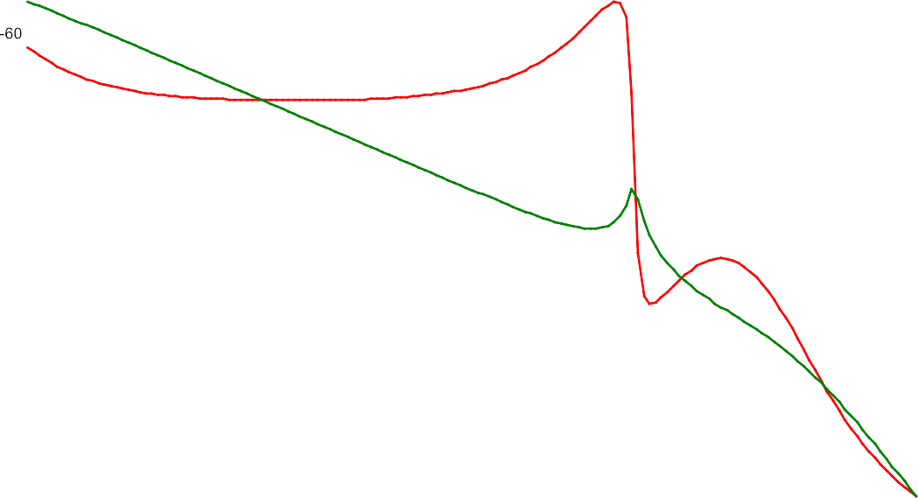

Simulations: First Example
Here is a buck converter:
Here are the results:
Return
Addition
Return
= −H ⋅ K ⋅C
Addition

Slide 38
Simulations: First Example
Changing the measurement setup, Measuring between Output (instead of return) and the addition point,
We have the plant:
Out
Addition
H =
^{V}OUT
Addition

Slide 39
Simulations: More Results with “Same” File…
For simplicity, we use the following hierarchical/block schematic :

Slide 40




Simulations: More Results with “Same” File…
For simplicity, we use the following hierarchical/block schematic :

Slide 41
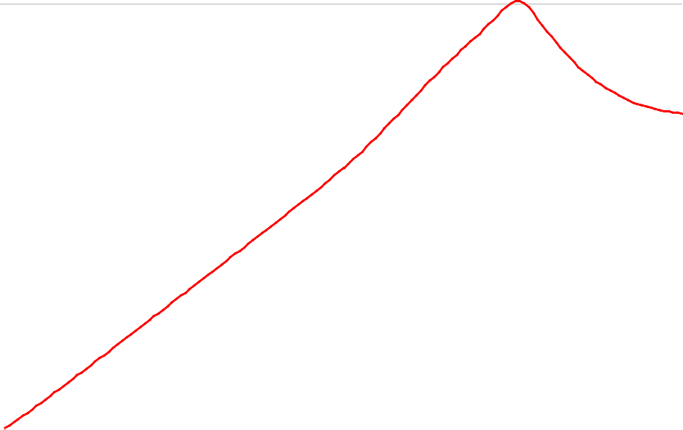


Simulations: More Results with “Same” File…
Output impedance:
Here is the setup: • Here are the results:
_{Z =} ^{V}OUT
OUT
I
OUT

Slide 42
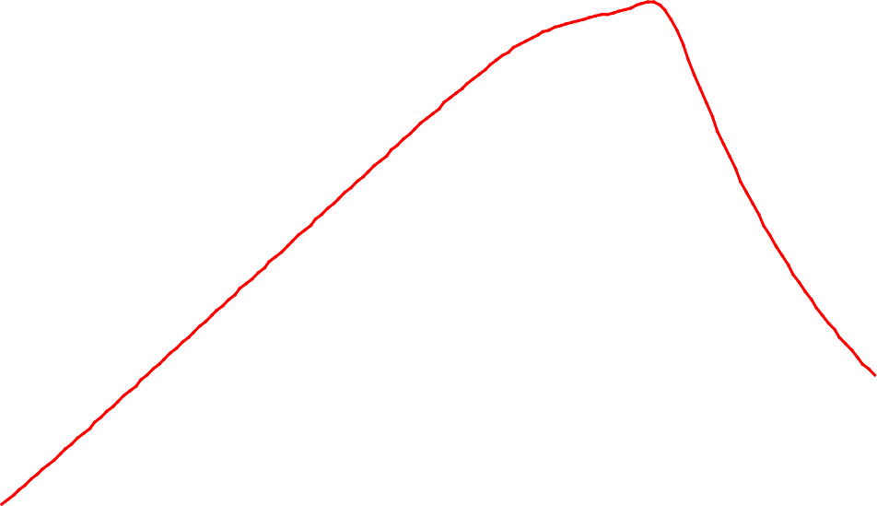
Simulations: More Results with “Same” File…
Input rejection ratio (PSRR):
Here is the setup: • Here are the results:
PSRR = ^{VOUT}
^{V}IN

Slide 43


Simulations: More Results with “Same” File…
Input impedance:
Here is the setup: • Here are the results:
_{Z =} ^{V}IN
IN
I
IN

Slide 44












Simulations: More Results with “Same” File…
Reference transient or tracking:
Here is the setup: • Here are the results:

Slide 45


Simulations: More Results with “Same” File…
Load and Input transients:
Load transient setup: • Input transient setup:

Slide 46
Measurement Method
With an Adder
Public Information © onsemi 2022

Slide 47
Measurement Method
The adder is made with an operational amplifier:
Return
R
R
R
NCS2005
Addition
ε
NCS2005
R
R=10kΩ or 1kΩ
To prevent dc level in the χ generator, we use a follower.
50Ω

Slide 48
Measurement Method
onsemi NCS2005 characteristics:
− 8-MHz bandwidth,
− Rail to rail,
− 2.8 V/µs slew rate,
− Supply voltage from 2.2 V up to 38 V,
− Low offset: 0.2 mV,
− Low supply current: 1.3 mA
− Maximum output current: 20 mA.

Slide 49
Measurement Method
Advantages :
− Large bandwidth,
  Several hundreds of kHz with NCS2005
− Very good linearity,
− Adder is a low-pass filter.
It always introduces a positive phase shift
  The real phase margin is always equal or higher that the measurement.
Cautions :
− The adder cannot be placed anywhere in the loop.
  Only in the small-signal path.
− The amplifier needs a positive (& negative) supply.
− The adder ground NEEDS to be connected to the plant ground.

Slide 50
Measurement Method
To avoid distortion, Ε should be small.
− Generally 20 mV rms is the minimum to use,
− Maximum 100 mV peak to peak.
Compensate probes before measurement.
Measurements are done in a very noisy environment :
− Use scope averaging more than 16 times,
− Limit scope bandwidth to 20 MHz
− Synchronize the scope and the generator.

Slide 51
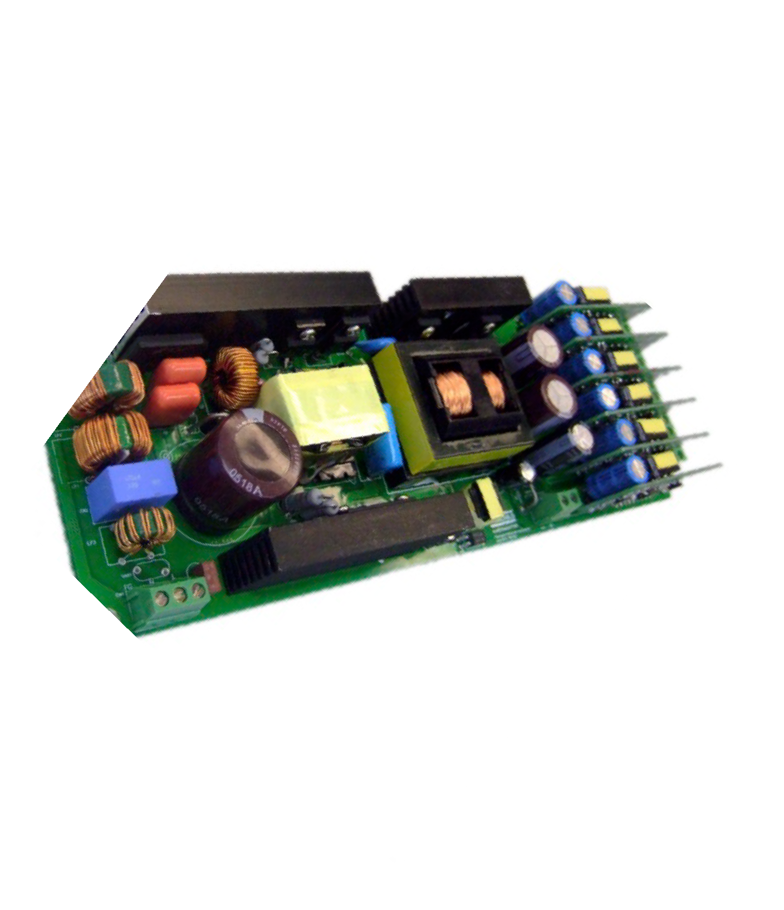
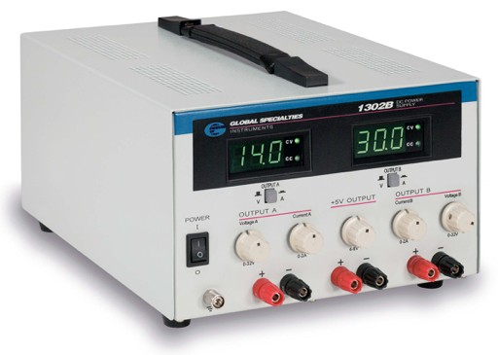
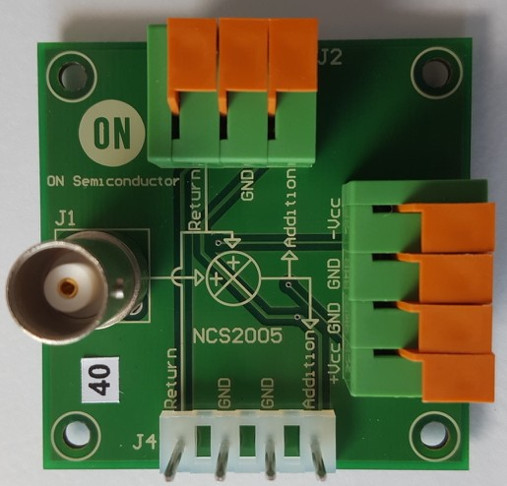
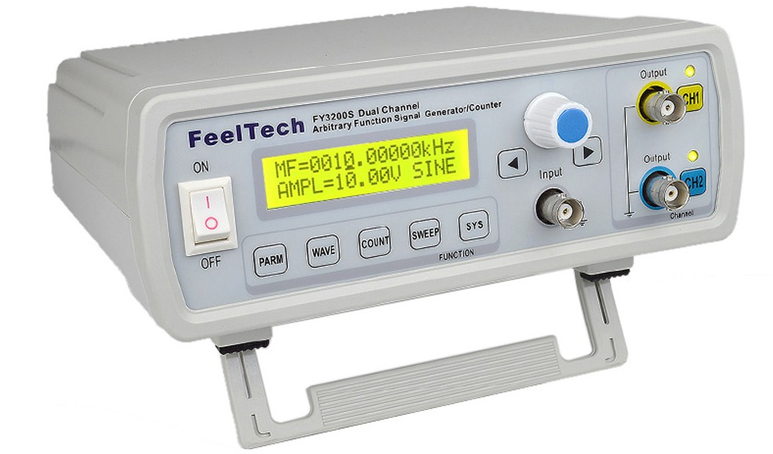
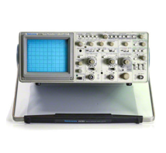
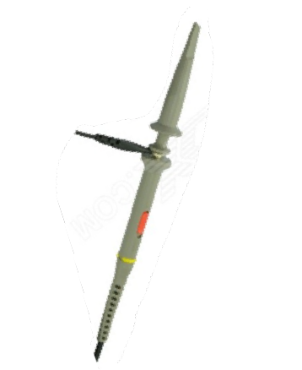
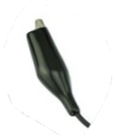
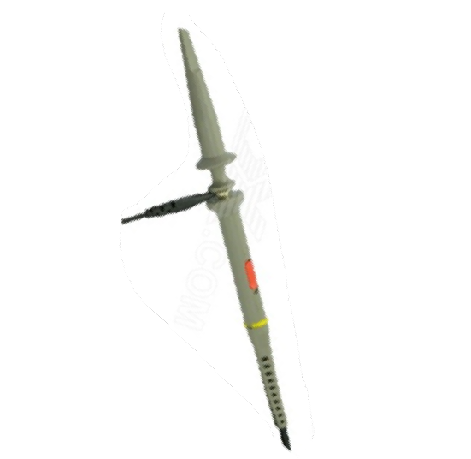
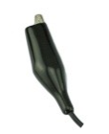
Here is the setup with the adder board :
Measurement Method
Output

Slide 52

Here is the setup with the adder board :
Measurement Method
Output
Video Tutorial :
https://www.onsemi.com/video/easy-control-loop-measurement-and- verification-example-board-used-fan65005-gevb-

Slide 53

Measurement Method
To measure a loop, the converter must be stable.
In order to begin, use a high-value capacitor in the compensator op-amp feedback path.
− This will slow down the transient response, but the loop will be stable.
− Increase also the soft-start duration if needed.
Due to modulator sampling effect, the maximum measurement frequency should be lower than half of the switching frequency.

Slide 54
Measurement Method
Fast method to verify stability criteria
− When Addition and Return exhibit same amplitude:
  This is when we are at the crossover frequency, the open loop gain is 0 dB,
  The phase shift between them represents the Phase Margin.
− When Addition and Return are in phase :
  The system open-loop phase is -180°,
  The gain between them is the Gain Margin.
We can also use a network analyzer for an automatic measurement of the open- loop transfer function.

Slide 55
Loop Optimization
Using a Math Software Program
Public Information © onsemi 2022

Slide 56
40
0
Loop Optimization: Measurement
Gain (dB) Phase (°)
Here an open-loop measurement
obtained with a network analyzer.
20
− 45
Gain(dB
)
Phase (°)
0
− 90
− 20
− 135
− 40
Frequency (Hz)
− 180
100
10³
10⁴
10⁵
•

Slide 57

Loop Optimization: Measurement Feedback
Here is the low-bandwidth feedback (−K・C) used for this measurement:
RH=19.75 kΩ RB=10 kΩ CA=100 nF RE=10 kΩ RS=4.75 kΩ CS=22 nF
CS
RS
RH
RE
CA
Output
100dB/1MHz
RB
We can now extract the plant H transfer function…

Slide 58
Loop Optimization: Plant Transfer Function
20
50
10
0
Phase (°)
Gain(dB)
0
− 50
− 10
− 100
Plant Gain (dB)
Plant Phase (°)
− 20
− 150
− 30
− 200
100 | ¹⁰ ³ Frequency | 10 ⁴ | 10⁵ | 100 | 10³ | Frequency | 10⁴ | 10⁵
 | (Hz) |  |  |  |  | (Hz)

Slide 59
Loop Optimization: Mathcad® Sheet
Amplifier Parameters :
A0 100.dB
fT 1.MHz
Common Variables or Functions :
Compensator Transfet Function :
fC
fT
fC = 10 Hz
Comp( f , RH, RB, CA, RE, RS , CS)
ω 2.π.f
A0
₁₀ 20
Z2 RS
1
i .CS.ω RH
A0
G_dB( X) 20.lg( X ).dB
ZH
1 i .RH.CA.ω RB
₁₀ 20
A( f)
f fC
P_°( X)
arg( X)
_{i} .
deg
KT
1
RB ZH
ZT KT.ZH Z1
Loading Measurement :
Row0 = Fréeuency Row 1 = Gain (dB) Row 2 = Phase (°)
RE ZT A( f).Z2
Measure
LIREPRN( Mes1)
.KT
NbV lignes( Measure)
NbV = 401
A( f).Z1 Z1 Z2
k 0 , 1 .. NbV 1
f Measure^{<0 >.}Hz
CompM Comp f , RHm, RBm, CAm, REm, RSm, CSm
GainV PhaseV
Measure^{<1 >} Measure^{<2 >} 180
k
k
Comp f_{k}, RHs, RBs, CAs, REs , RSs , CSs
CompS_{k}
GainV
_{TM.} CompS
TM 10
20
_{.e}i .( PhaseV
180).deg
TS
CompM

Slide 60
Loop Optimization: Optimized Feedback
Here is new compensator used to boost phase and increase phase margin and bandwidth:
RH=19.75 kΩ RB=10 kΩ CA=680 pF RE=2.2 kΩ RS=10 kΩ CS=1 nF
Let’s compare and see the new open-loop plots …
CS
RS
RH
RE
CA
Output
100dB/1MHz
RB

Slide 61
Loop Optimization: Feedback Comparison
New Feedback Phase Boost
40
Measurement FB Gain (dB) Optimized Feedback
45
Phase (°)
30
0
20
Gain(dB)
10
− 45
Measurement FB Phase (°) Optimized Feedback
0
− 10
− 90
100 | 10³ | Frequency | 10⁴ | 10⁵ | 100 | 10³ | Frequency | 10⁴ | 10⁵
 |  | (Hz) |  |  |  |  | (Hz)

Slide 62
Loop Optimization: Open-Loop Comparison
New Open-Loop Bandwidth New Open-Loop Phase Boost
60 0
40
− 45
Phase (°)
20
Gain(dB)
− 90
0
− 135
− 20
Measurement OL Gain (dB) Optimized Open-Loop
Measurement OL Phase (°) Optimized Open-Loop
− 40
− 180
100 | ¹⁰³ Frequency | 10⁴ | 10⁵ | 100 | 10³ | Frequency | 10⁴ | 10⁵
 | (Hz) |  |  |  |  | (Hz)

Slide 63



Measurement Open-Loop Optimized Open-Loop
Loop Optimization: Open-Loop Comparison
Black-Nichols chart
60
45° minimum Phase Margin is maintained over
+/-10-dB Gain change
40
Gain(dB)
-45°
20
+/-10dB
−1
0
− 20
New Phase Margin = 60°
− 40
− 180
− 150
− 120
− 90
− 60
− 30
0
Phase (°)

Slide 64
Conclusion
Simulation versus Measurement
Public Information © onsemi 2022

Slide 65
Conclusion: Simulation versus Measurement
Most of the time, simulation and measurement are seen as two independent ways to obtain similar results…
Fans of both methods are fighting each other sometimes.
However, measurement is the only referee to verify simulation.

Slide 66
Conclusion: Why Measuring the Loop ?
Measurements are real and you get the full system picture.
By measuring the loop, you integrate all parasitics and nonlinear effects.
You can check your calculus and margins.
You can assess the impact of input and output filters.

Slide 67
Conclusion: Simulation AND Measurement
Simulation can be used during the design phase to predict system behaviors.
Measurements can be done for verifying design and fine-tuning the system in a real environment.
Simulation and measurements can be used together to bring a more complete system view.
Don’t rely only on one approach…
  Use Simulation AND Measurement !

Slide 68











Follow Us @onsemi
www.onsemi.com

