Slide 1
NCP730 150mA 38V Technical Presentation
Ivan Miksanek, Tim Hedquist
t.hedquist@onsemi.com
June 2022

Slide 2
NCP730 – Main Features
Wide input voltage range 2.7V – 38V
Wide output voltage range 1.2V – 24V (both FIX and ADJ)
High output voltage accuracy ±1% (-40 to 85degC); -1/+2% (-40 to 125ºC)
Output current up to 150mA (200mA peak)
Low dropout voltage: typ. 290mV @ 3.3V, 150mA / 245mV @ 5V, 150mA
PG output device option (B version)
Stable with 1uF – 100uF output ceramic capacitor
Built-in soft start circuit
Low dropout (dropout depends on voltage variant, load current and temperature)
Low quiescent current, typ. 1.3uA (A version – no PG), 1.8uA (B version – with PG)
Very good transient response and PSRR (note this is 1uA device!)
Two industry-standard packages TSOP−5 and WDFN6 2x2 mm

Slide 3
NCP730 to TI TPS709 Comparison
Why use the NCP730?
  VIN_max up to 38V; covers 24VAC common wire requirements
  Vout range from 1.2V – 24V
  Faster transient response
  Available in fixed & adjustable configurations
  Power Good (PG) is available
  Available in TSOP5 & WDFN6_2x2
  Direct drop-in, P2P, to TPS709 with improved performance!

Slide 4
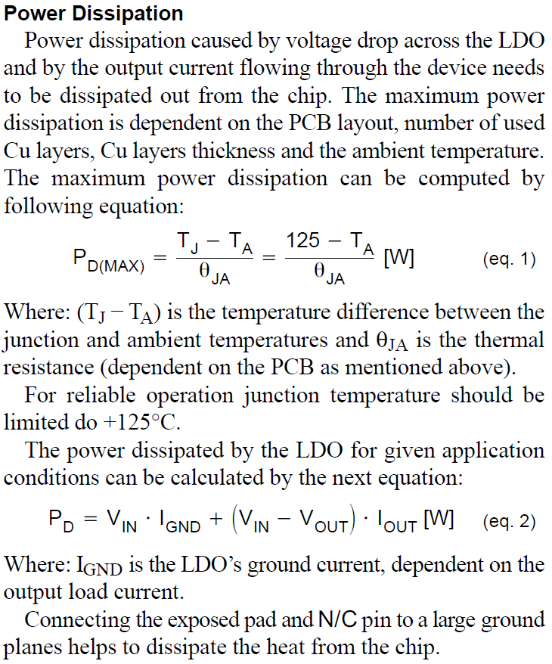
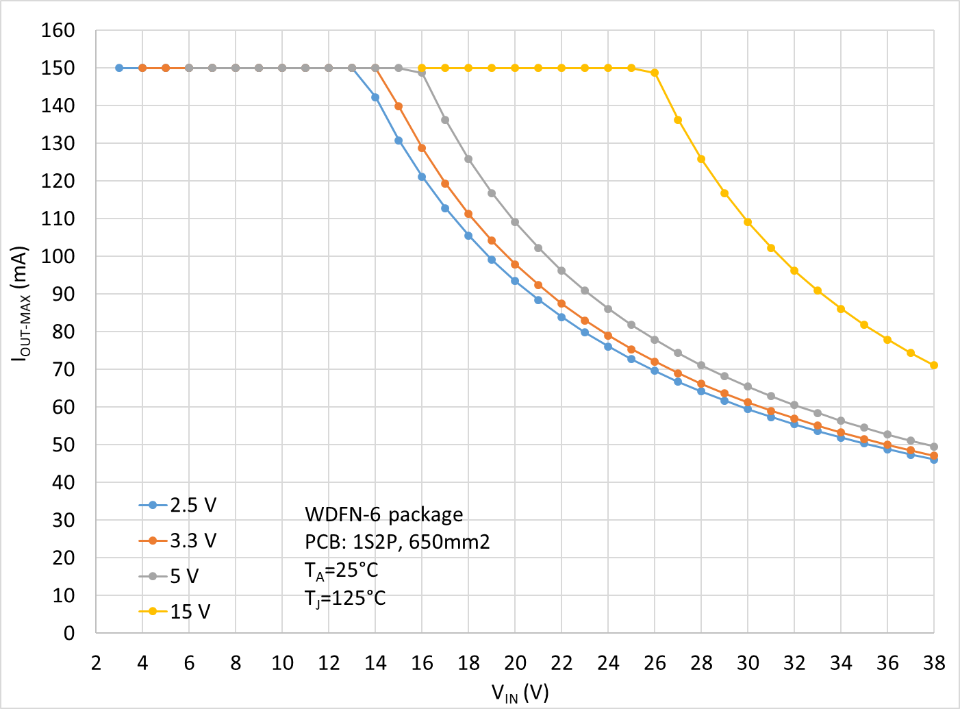
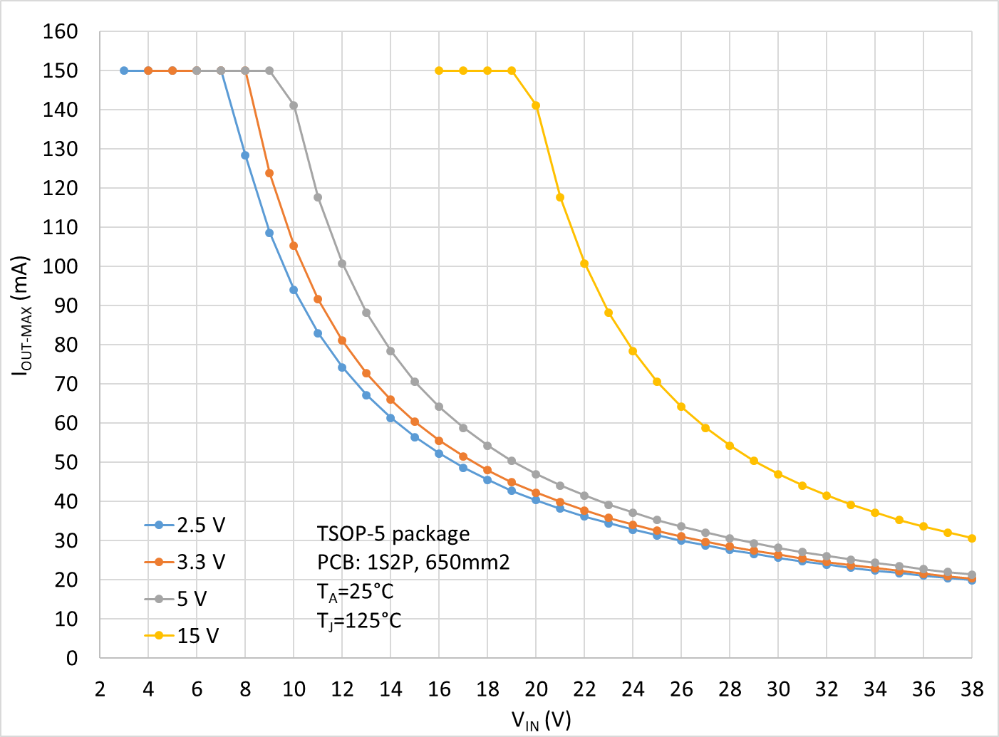
NCP730 – Max Output current vs. Input voltage
WDFN-6 package
TSOP-5 package
Max. output current shown at these graphs is computed from max. power dissipation (PCB, T_{A} and T_{J} dependent) and desired output voltage version by equation: I_{OUT-MAX} = P_{DIS-MAX} / (V_{IN} – V_{OUT-NOM}) at T_{A}=25°C and T_{J}=125°C, for JEDEC test board with Cu area 650mm², thickness 1oz. It means that on different customer’s PCB and/or different T_{A} and T_{J} inputs the graphs will look different.

Slide 5
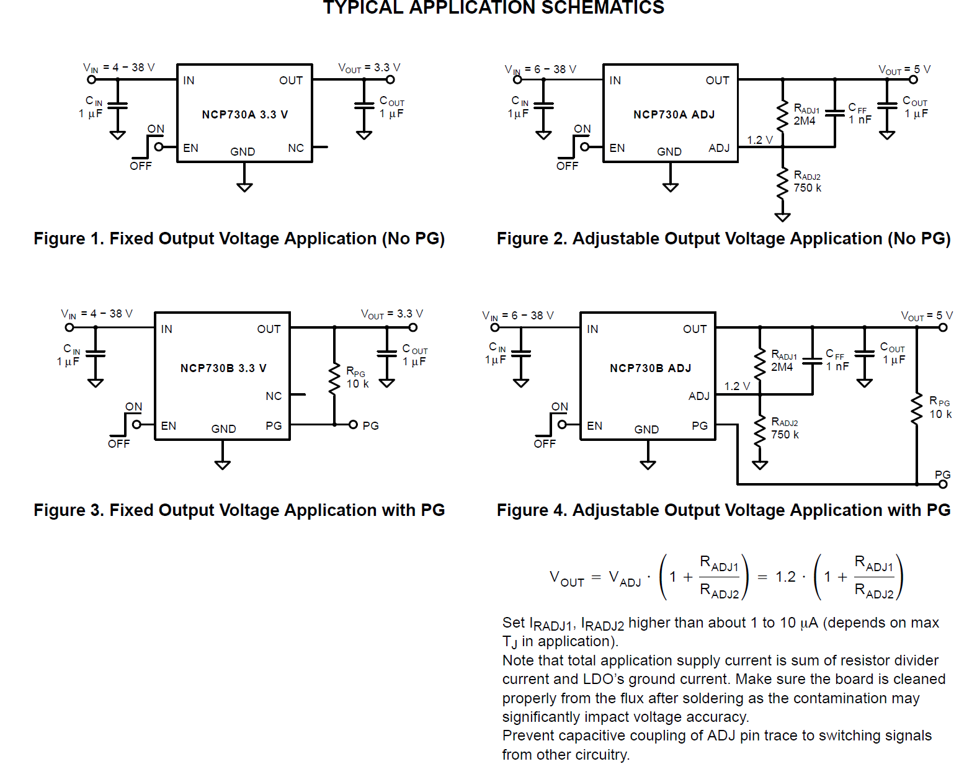
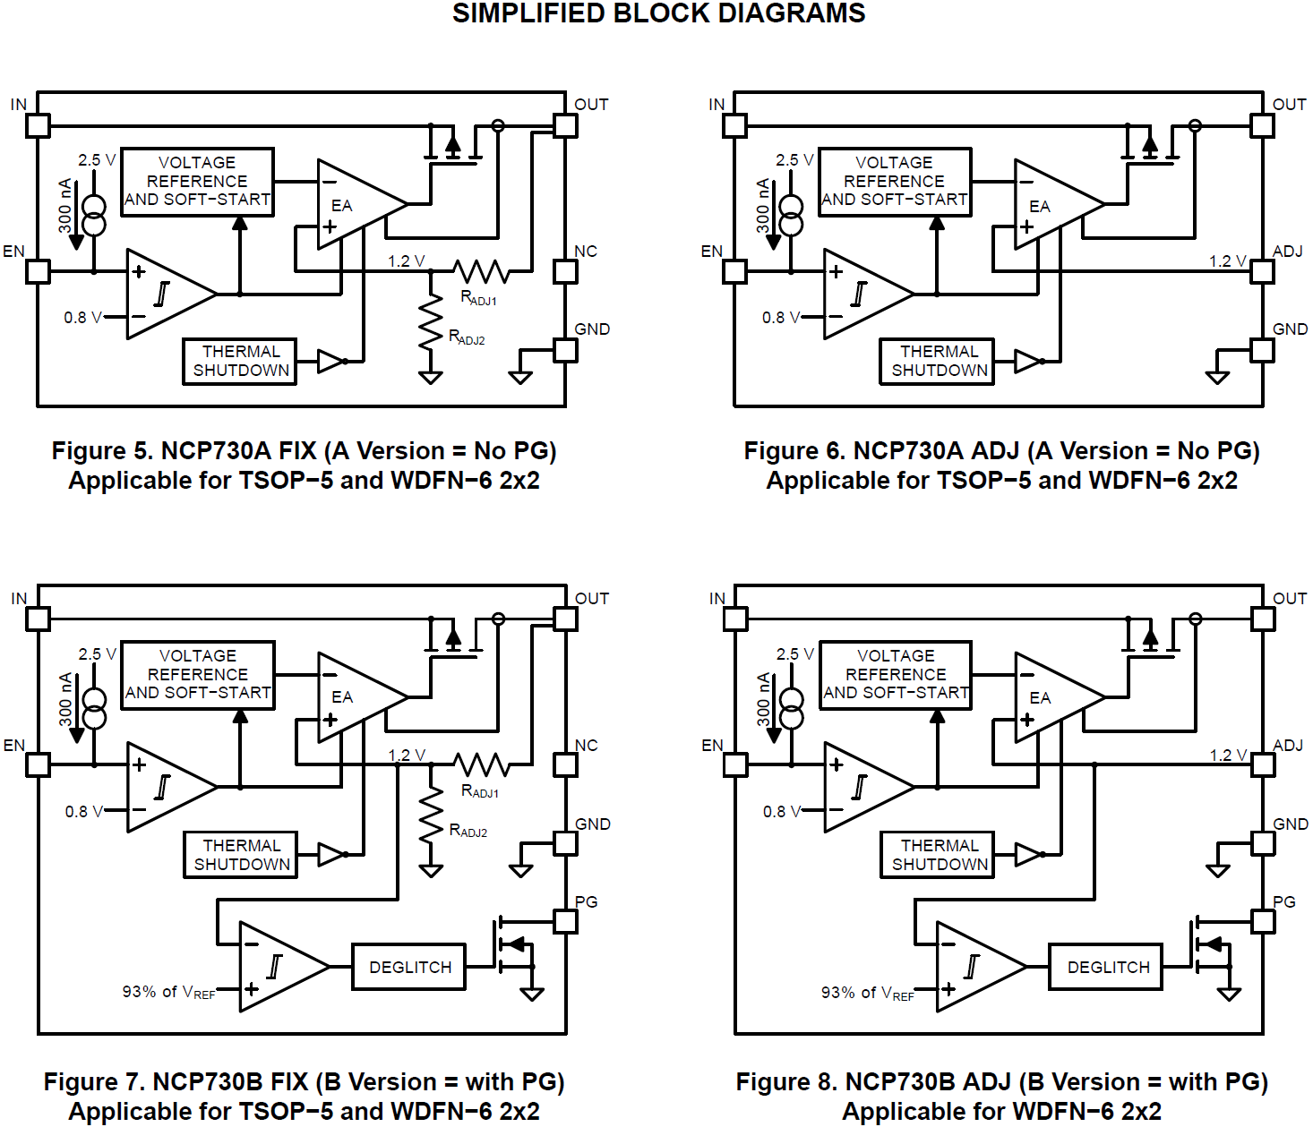
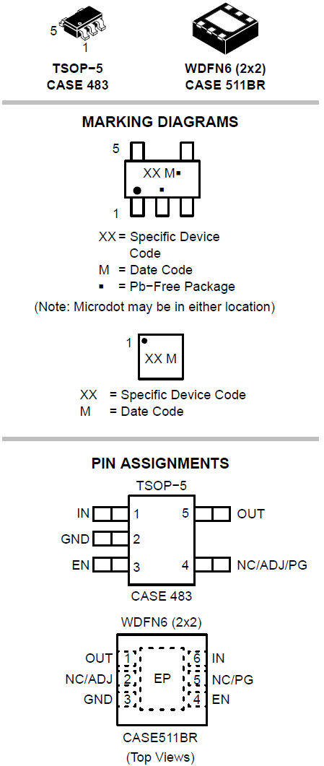
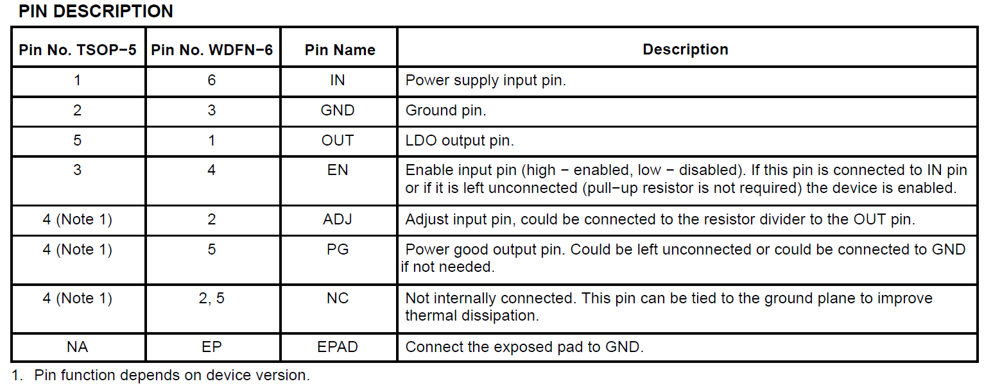
NCP730 – Basic Applications, Block Diagrams, & Pinouts

Slide 6
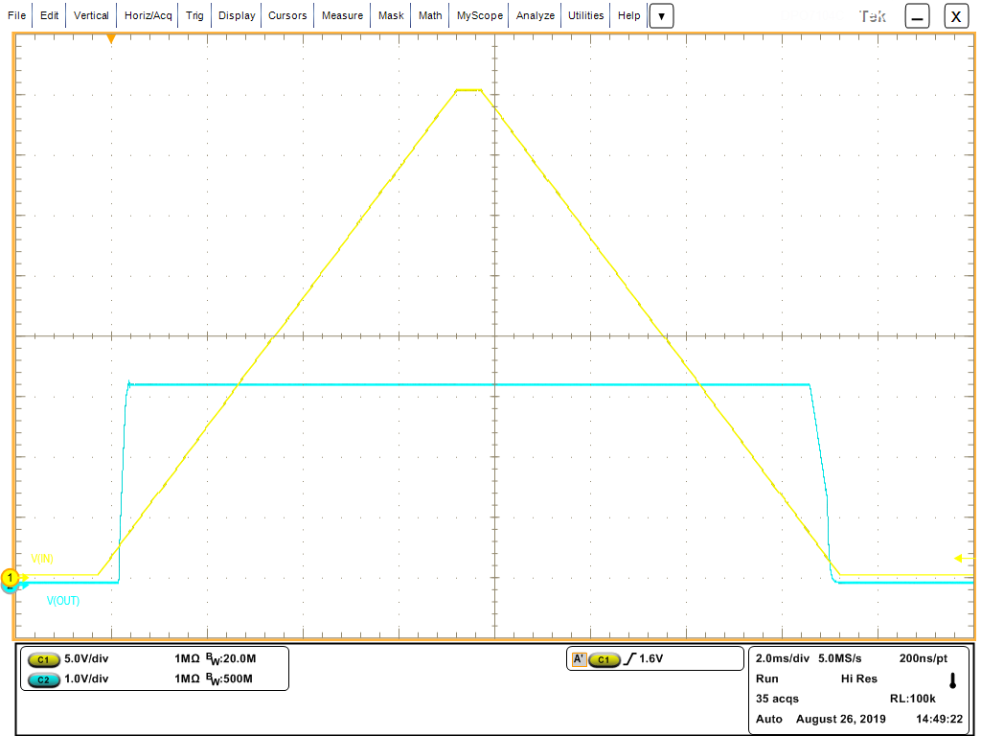
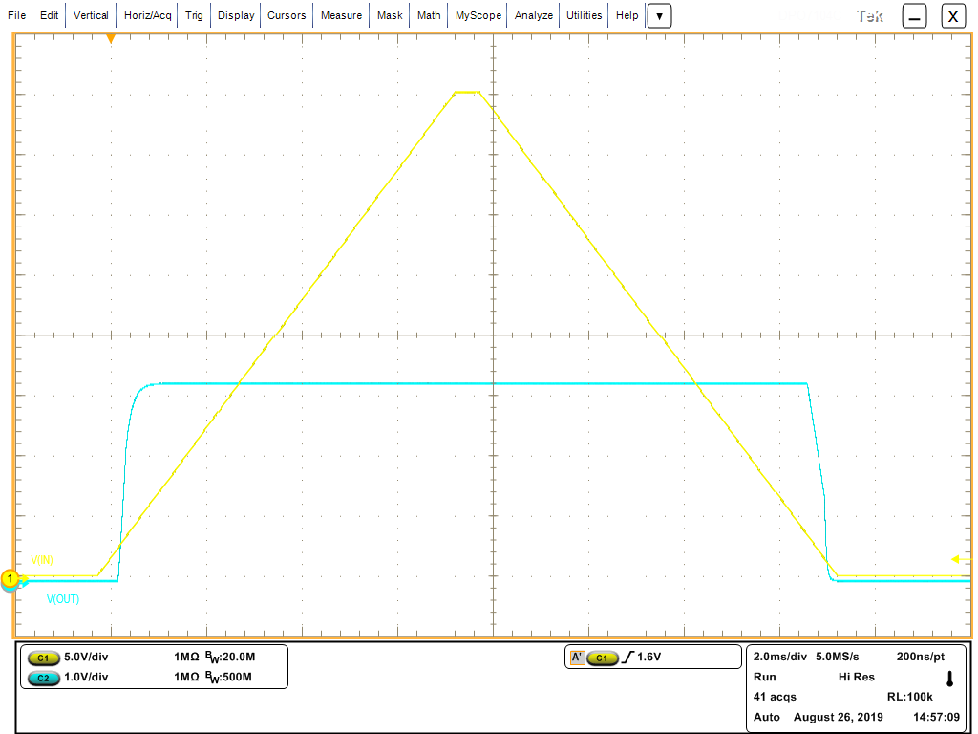
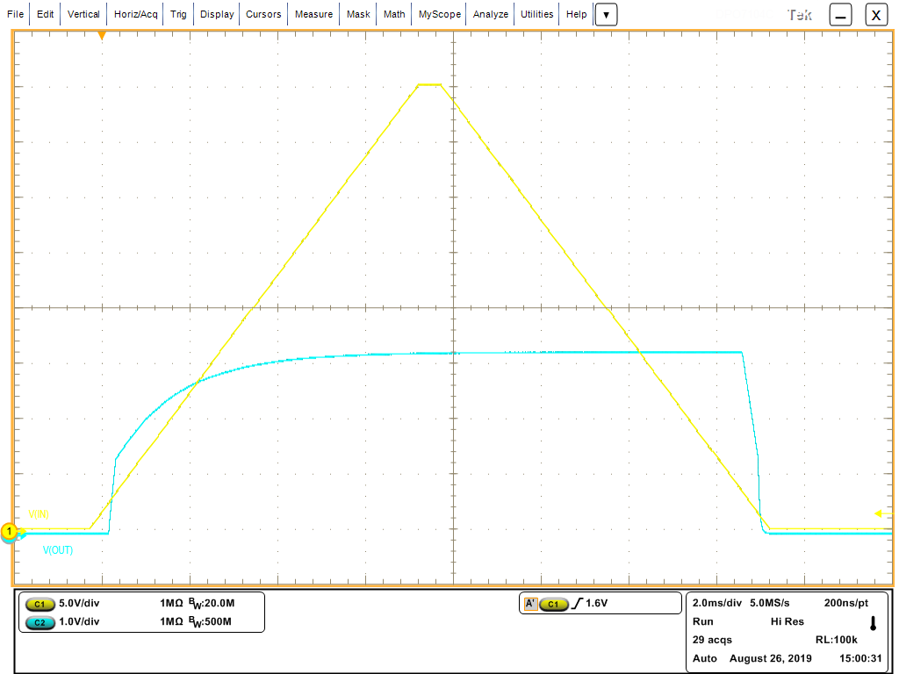

Start-up by V_{IN} (slow) - NCP730-ADJ-3.3V
C_{ADJ1} = 0pF, C_{OUT} = 1uF
C_{ADJ1} = 100pF, C_{OUT} = 1uF
C_{ADJ1} = 1nF, C_{OUT} = 1uF
V_{IN}
V_{IN}
V_{IN}
V_{OUT}
V_{OUT}
V_{OUT}
Common conditions: Vin=0V->40V, Iout=100mA
C_{ADJ1} = 1nF, C_{OUT} = 47uF
Purpose of this slide is to show the influence of C_{ADJ1} (feed-forward) capacitor and C_{OUT} capacitor to speed of V_{OUT} rise/fall after start-up by V_{IN}.
Note that V_{IN} and V_{OUT} scales are different (not important in this case).
No overshoot of V_{OUT} observed.
V_{IN}
V_{OUT}

Slide 7
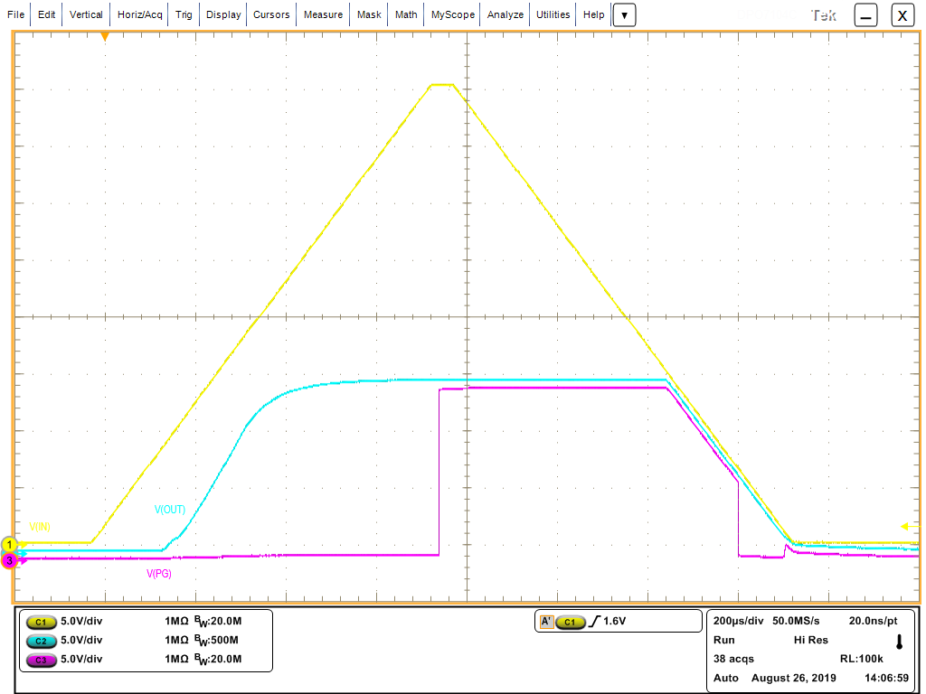
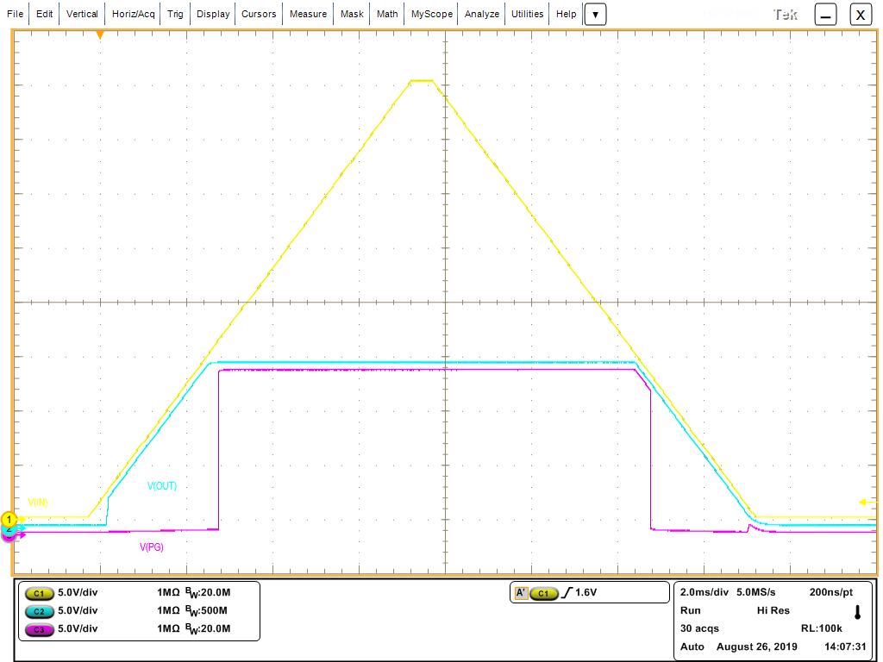
Start-up by V_{IN} (medium & slow) - NCP730-15V
Vin=0V->40V, Iout=100mA, Cout=1uF
V_{IN} ramp times tr=tf=600us (medium)
V_{IN} ramp times tr=tf=6ms (slow)
V_{IN}
V_{OUT}
V_{PG}
V_{IN}
V_{OUT}
V_{PG}
No overshoot of V_{OUT} observed.

Slide 8
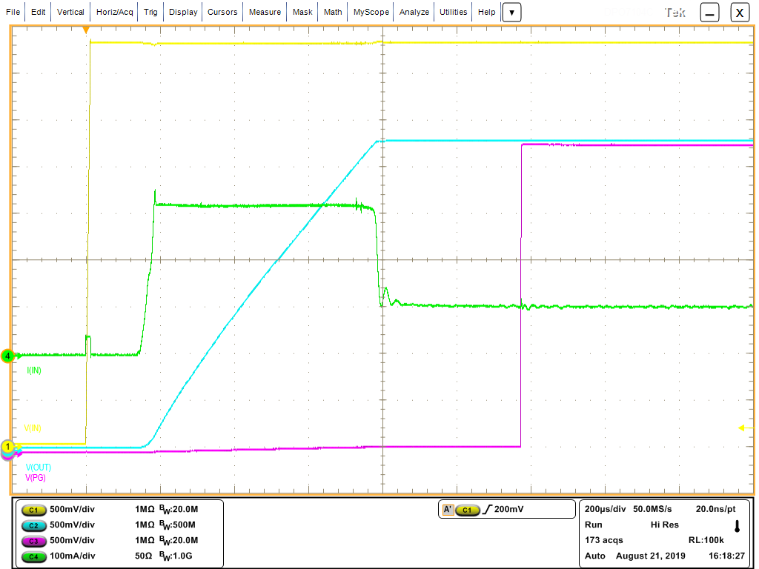
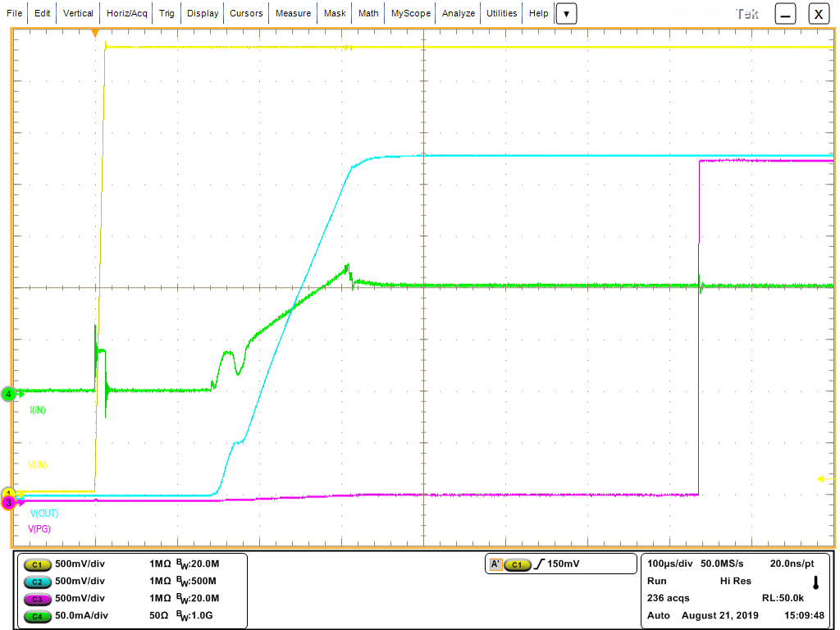
Start-up by V_{IN} (fast) - NCP730-3.3V
C_{OUT}=47uF
C_{OUT}=1uF
4.3V
4.3V
The V_{OUT} rise speed is given by C_{OUT}, I_{OLIM} and I_{LOAD}. C_{OUT} is charged by shown I_{IN} minus I_{LOAD} (100mA). Internal soft start is normally faster.
The V_{OUT} rise speed is given internal soft start.
Here the LDO is in regulation.
3.3V
Here the LDO is in regulation.
3.3V
Here the LDO limits output current to I_{OLIM} level.
Here V_{PG} copies V_{OUT} because PG is connected to OUT pin by R_{PG} resistor.
PG indicates the power is OK
Here V_{PG} copies V_{OUT} because PG is connected to OUT pin by R_{PG} resistor.
PG indicates the power is OK
Current pulse caused by C_{IN} charging
I_{IN}=I_{LOAD}=100mA
Current pulse caused by C_{IN} charging
I_{IN}=I_{LOAD}=100mA
I_{IN}
I_{IN}
Here V_{PG} is almost 0V (current from OUT pin through external R_{PG} causes voltage drop at internal PG’s N-MOS).
PG indicates power is NOT ok.
Here V_{PG} is almost 0V (current from OUT pin through external R_{PG} causes voltage drop at internal PG’s N-MOS).
PG indicates power is NOT ok.
V_{IN}
V_{OUT}
V_{PG}
I_{LOAD}=100mA
V_{IN}
V_{OUT}
I_{LOAD}=100mA
0V
R_{PG}=10kΩ
0V
R_{PG}=10kΩ
C_{OUT}=47uF
V_{PG}
C_{OUT}=47uF

Slide 9
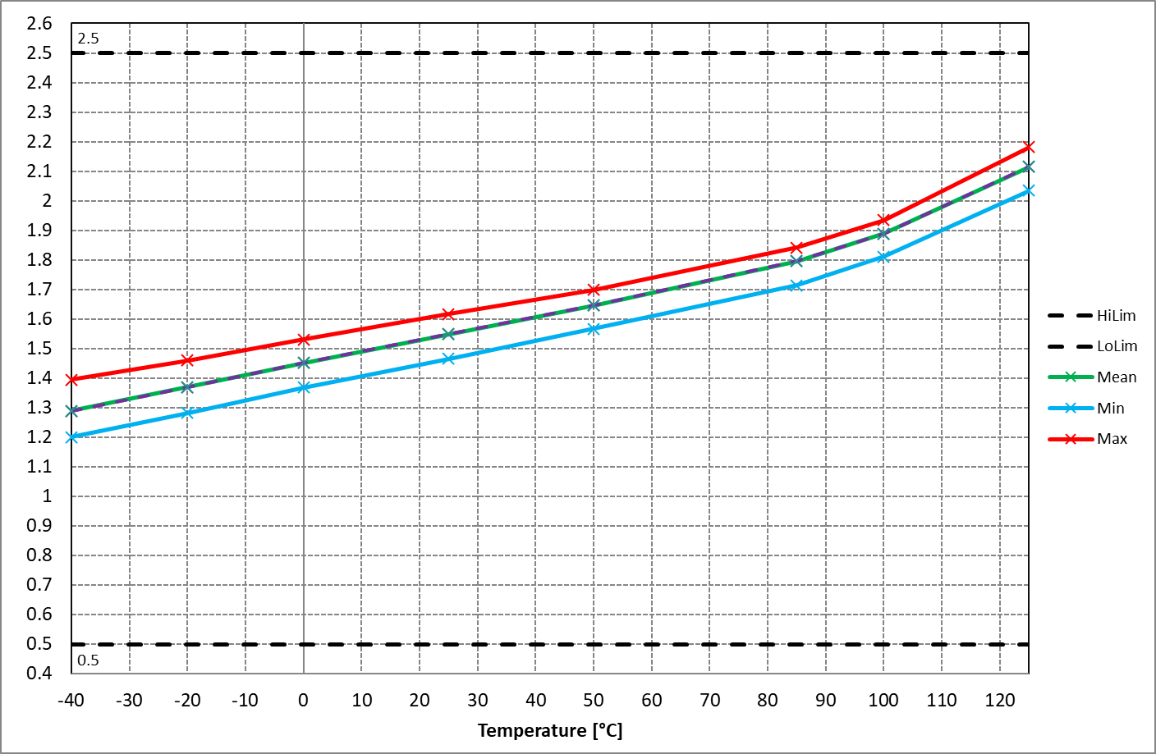
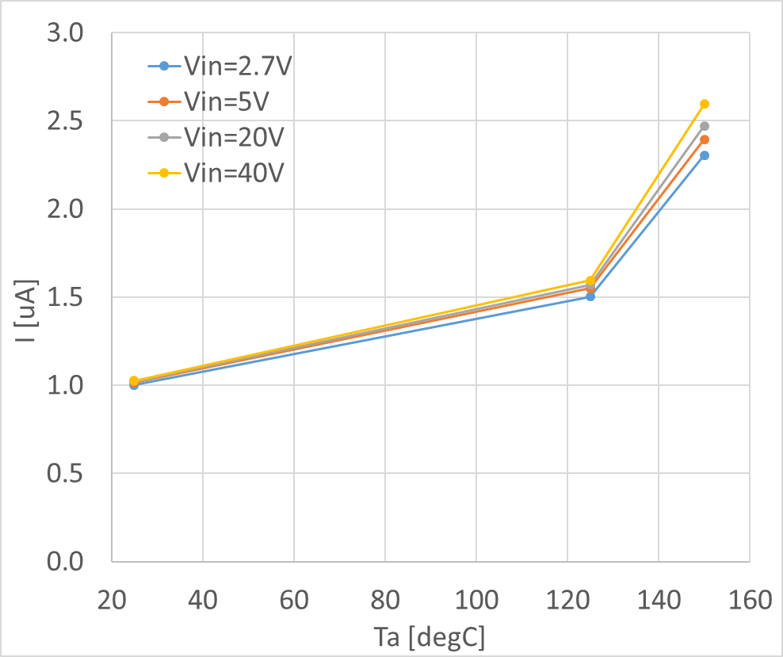
NCP730-5.0V – Quiescent current (I_{Q}), I_{OUT}=0mA
V_{IN}=38V over temp
GND pin current @ 150mA (ATE)
Quiescent current, I_{Q} [uA]

Slide 10
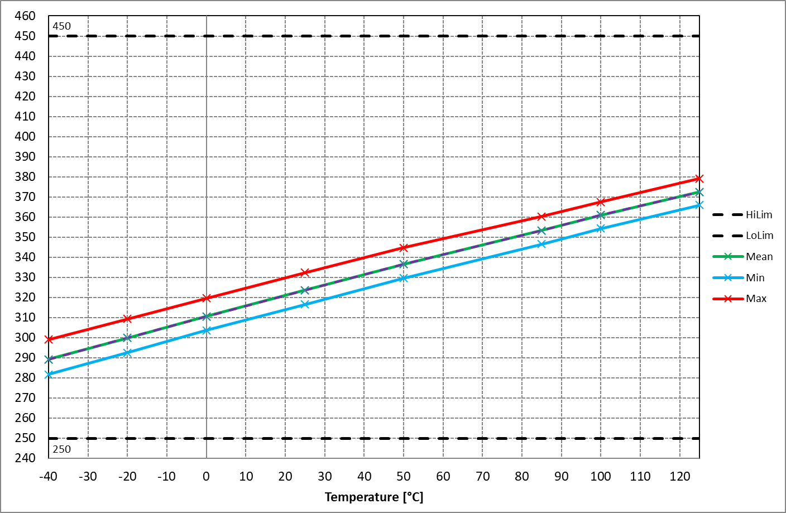
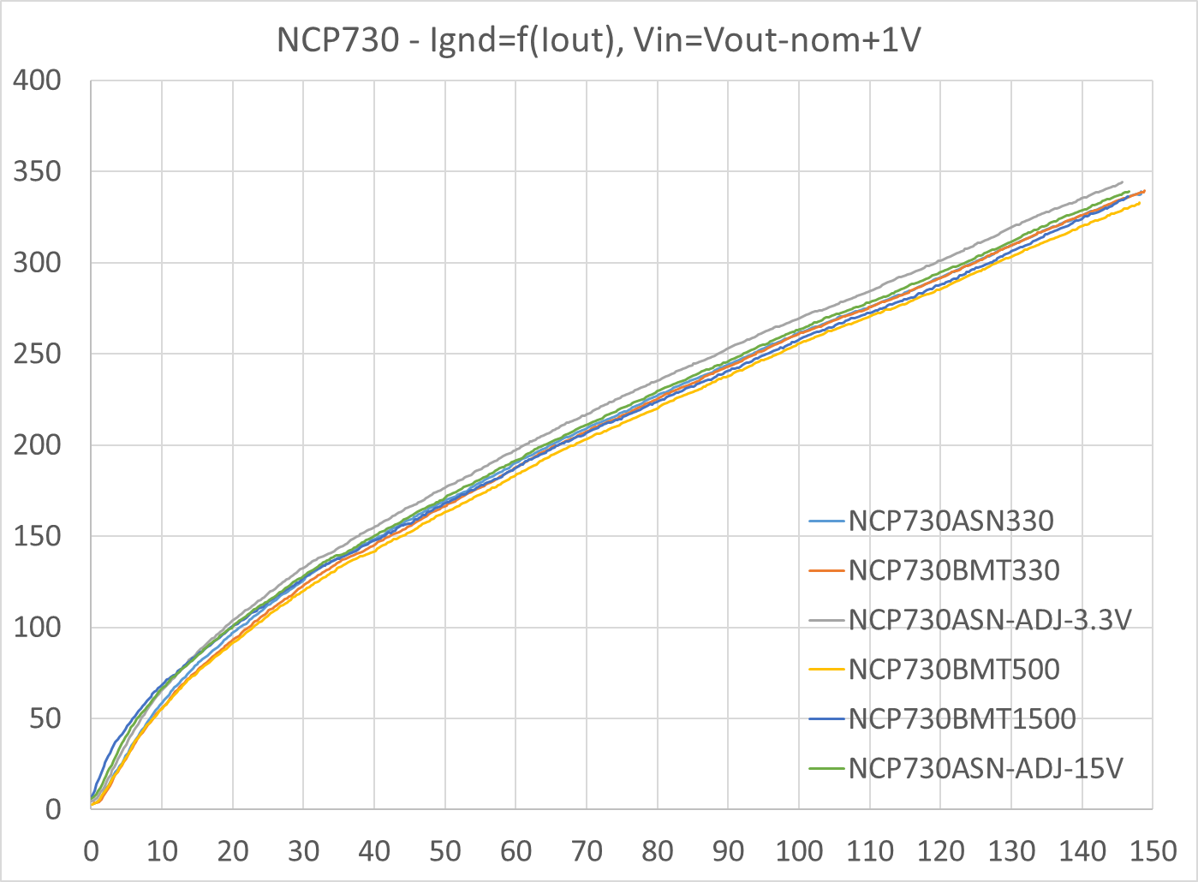
NCP730 Ground Current
I_{OUT}=150mA over temperature
Ground current vs. Output current
T_{J}=25°C
Ground current, I_{GND} [uA]
Output current, I_{OUT} [mA]

Slide 11
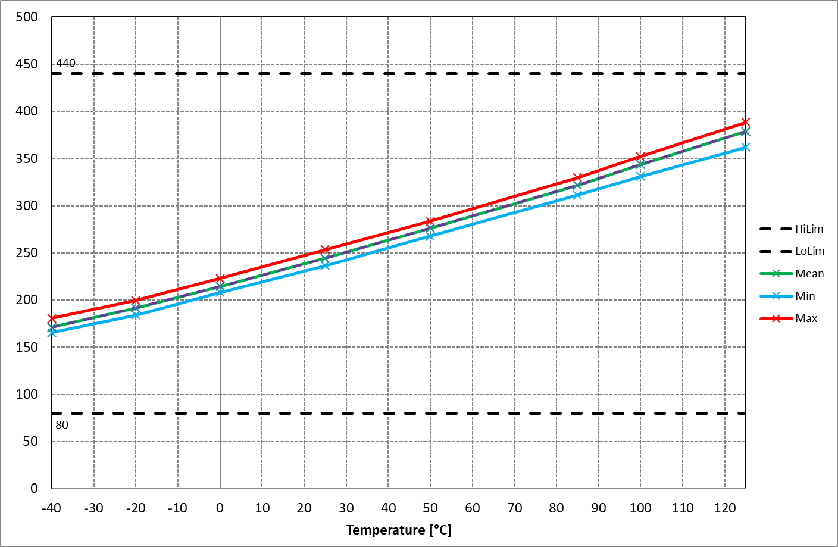
NCP730-5.0V – Dropout voltage over temperature
Dropout voltage, V_{DO} [mV]

Slide 12
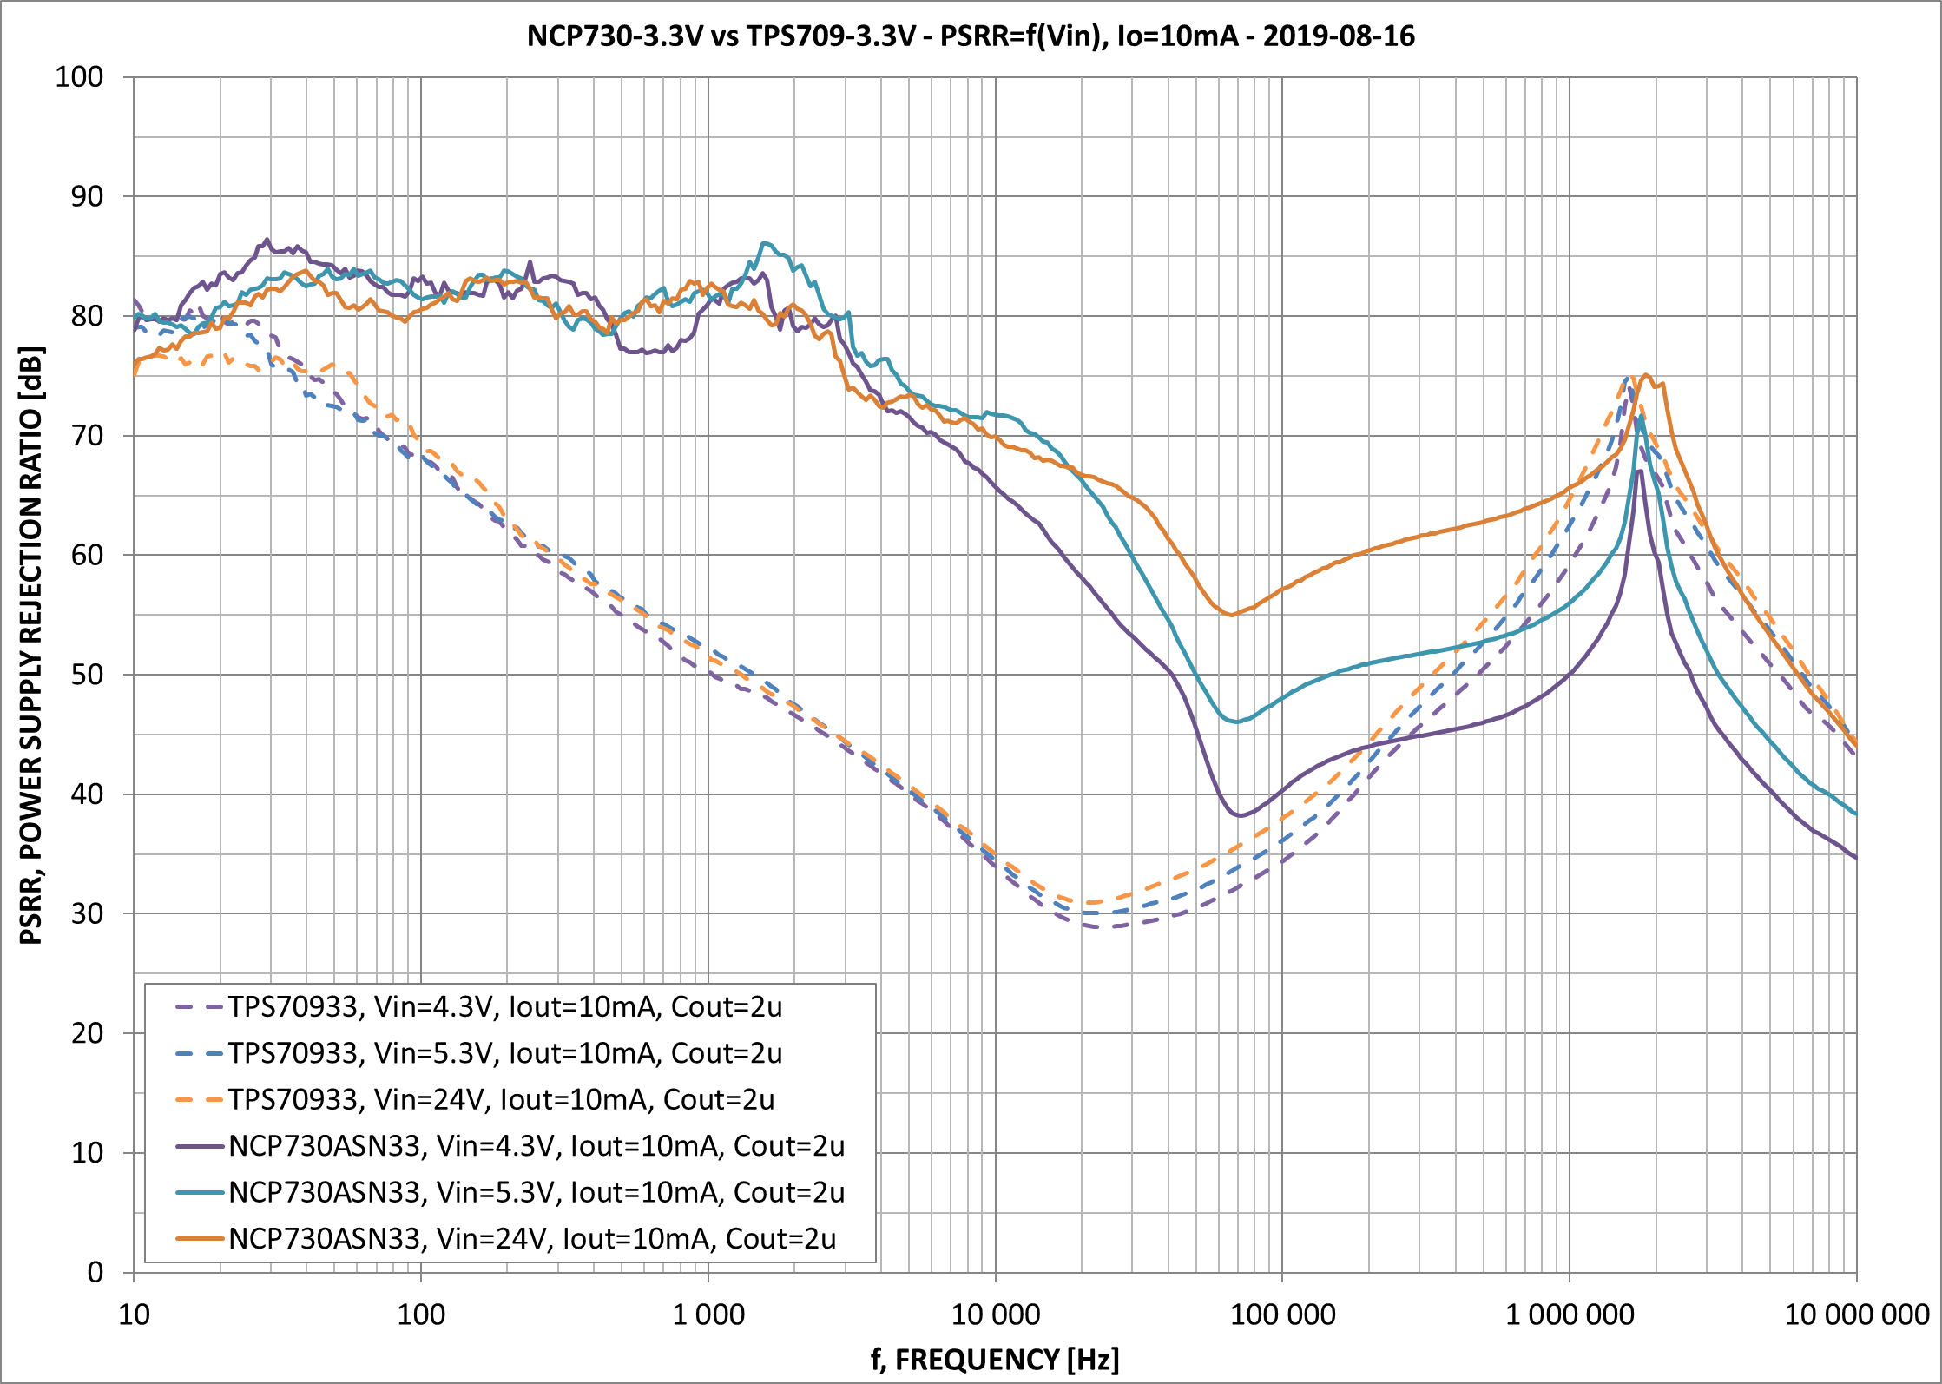
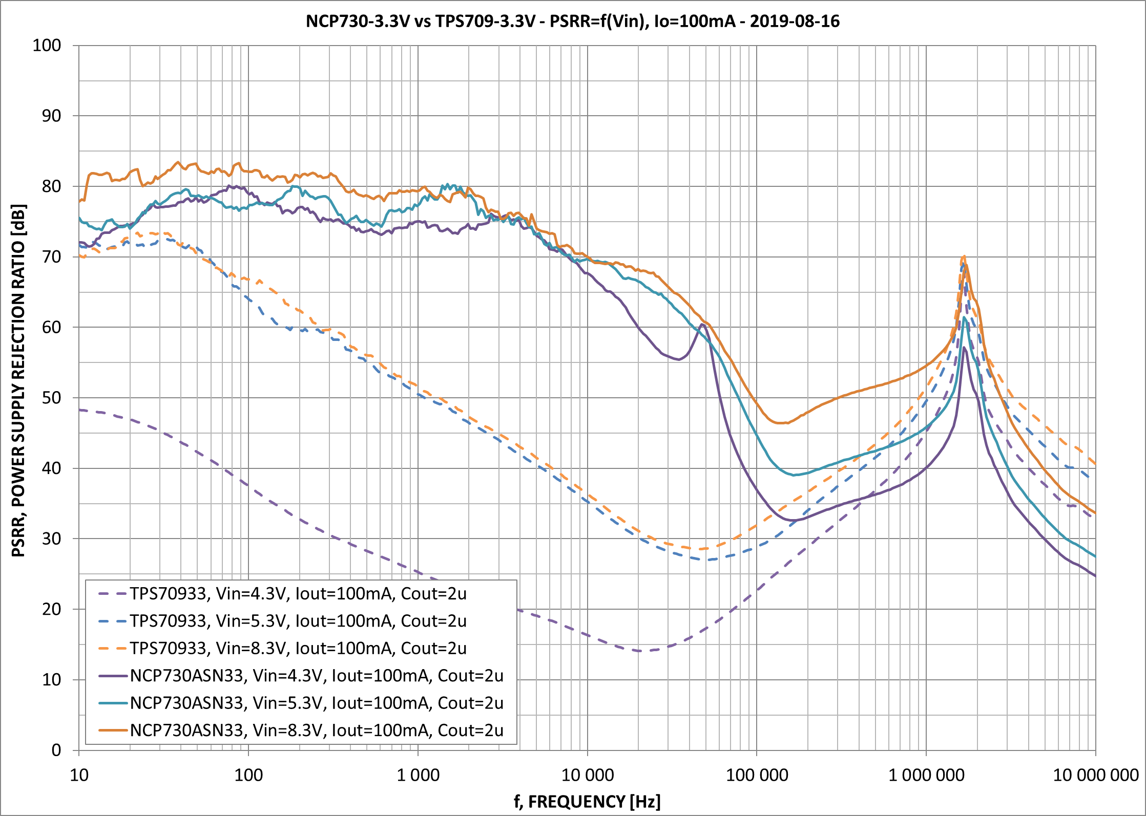
PSRR – NCP730ASN330 vs TPS70933, V_{IN}=VAR, I_{OUT}=10/100mA

Slide 13
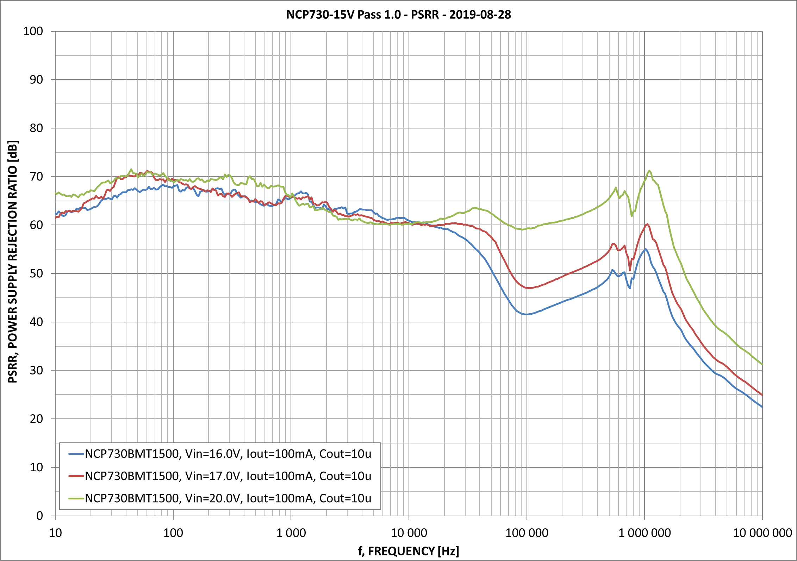
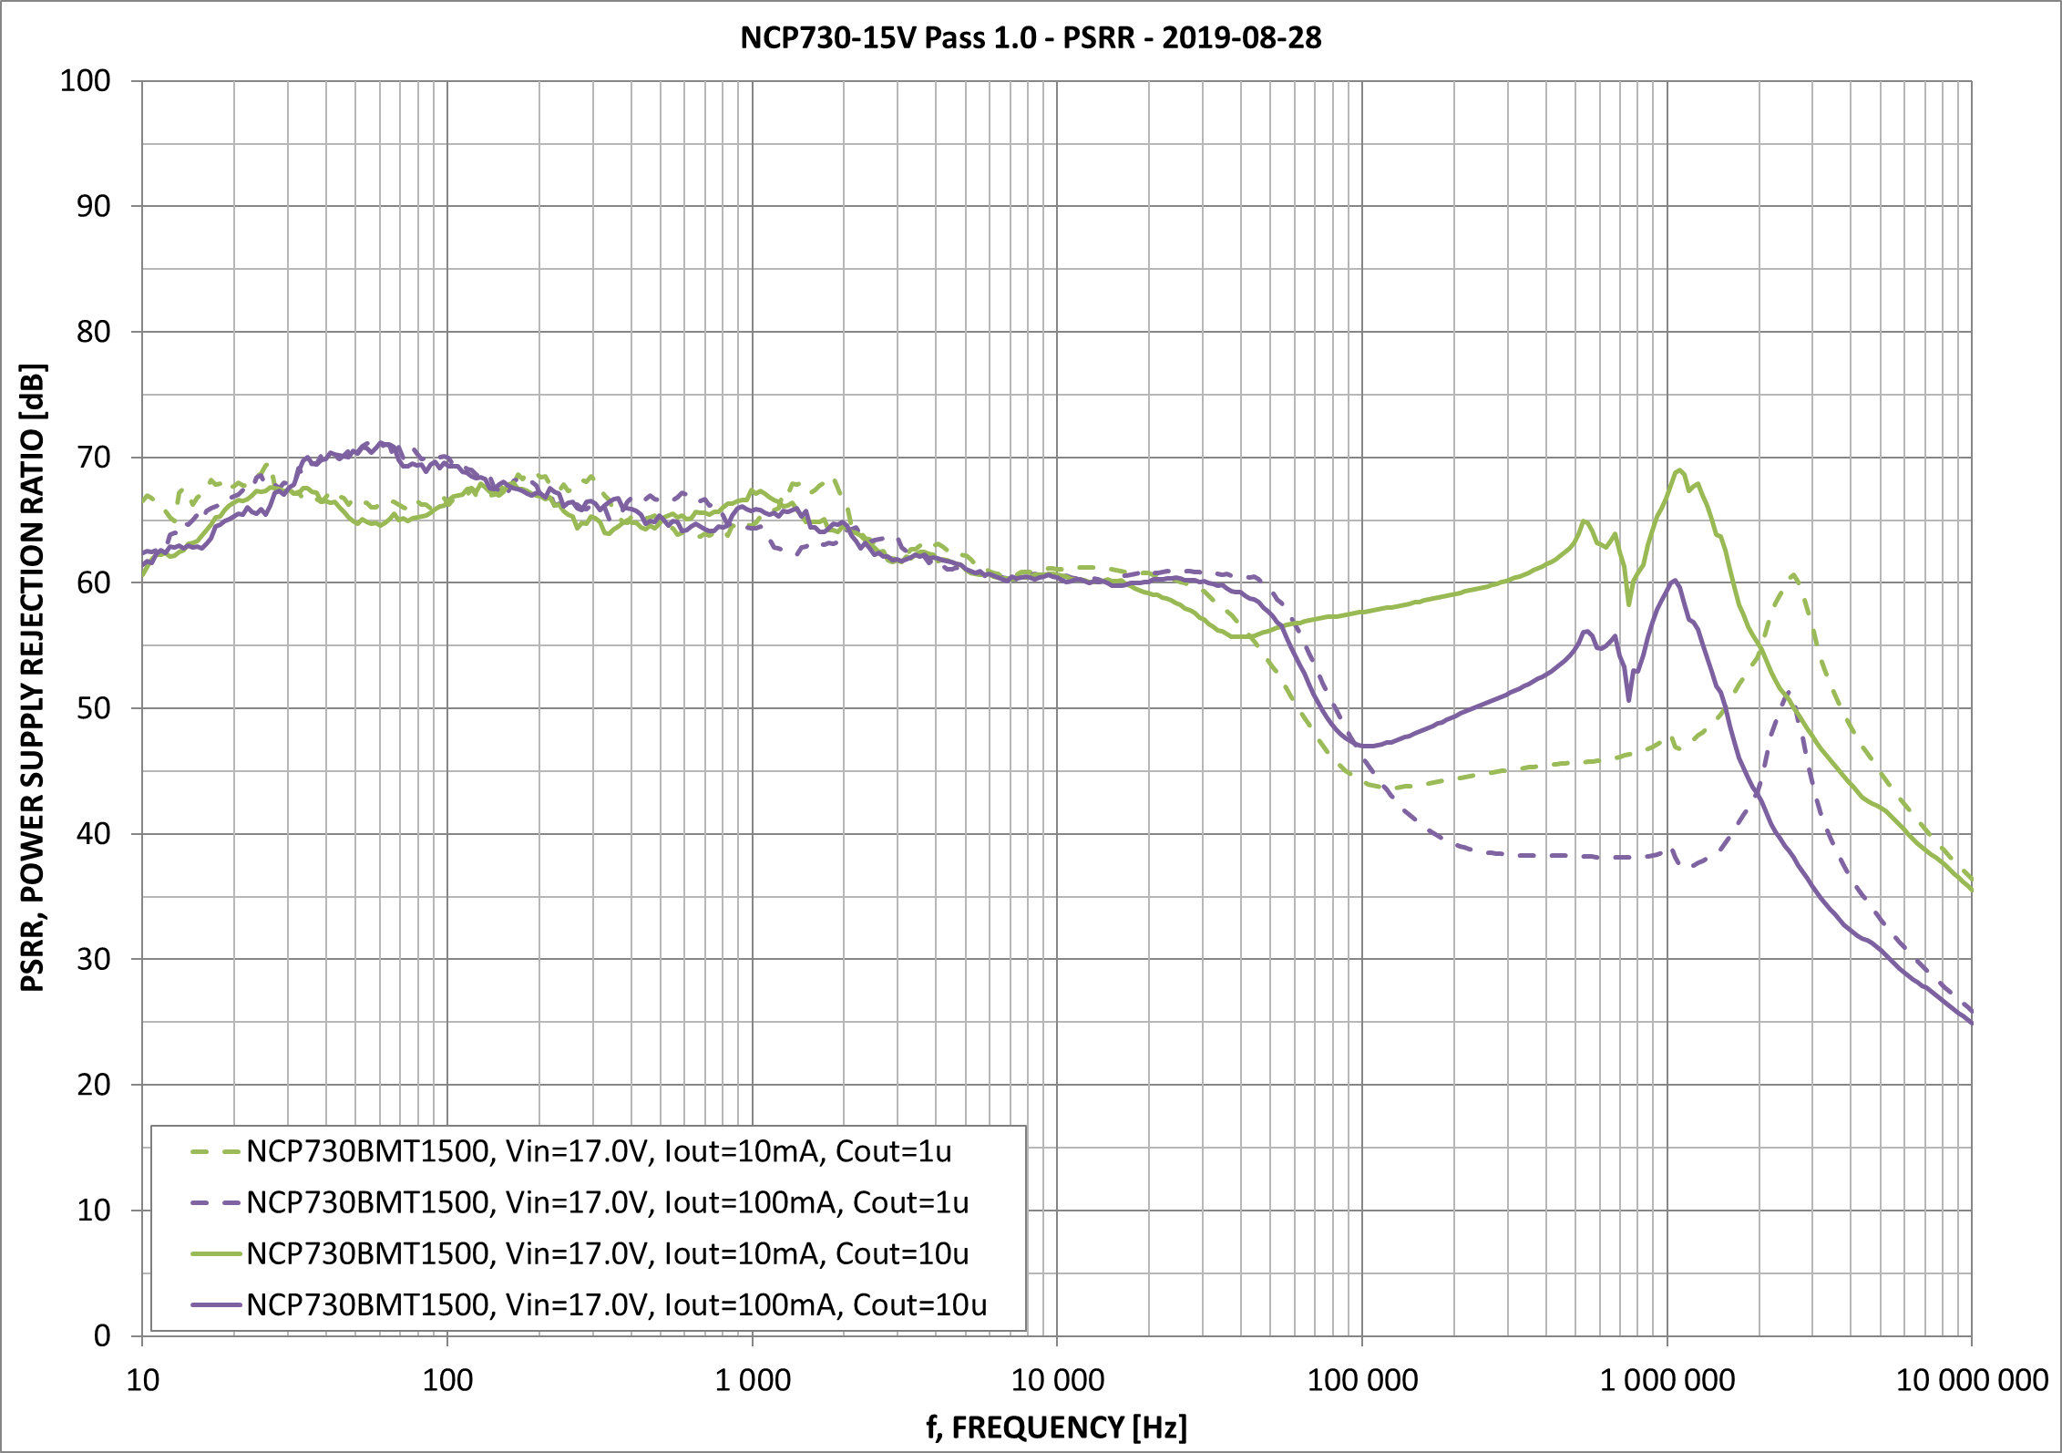
PSRR - Comparing VIN to Cout
C_{OUT}=10uF, V_{IN}=VAR, I_{OUT}=10/100mA
C_{OUT}=1/10uF, V_{IN}=17V, I_{OUT}=10/100mA

Slide 14
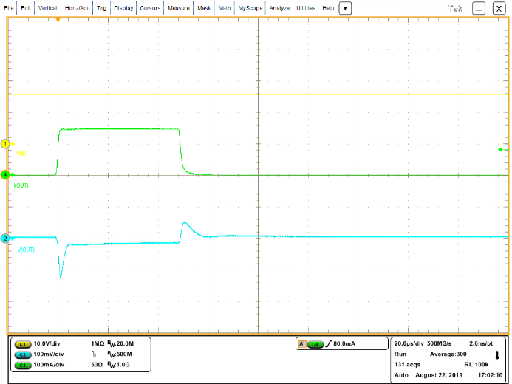
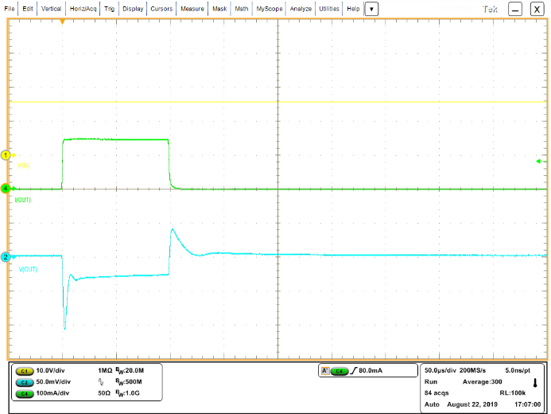
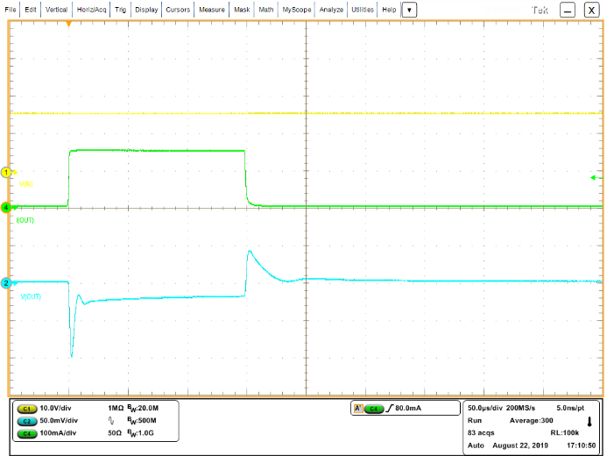
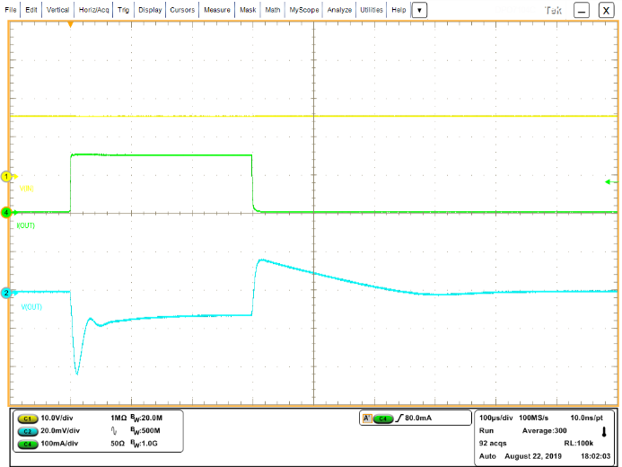
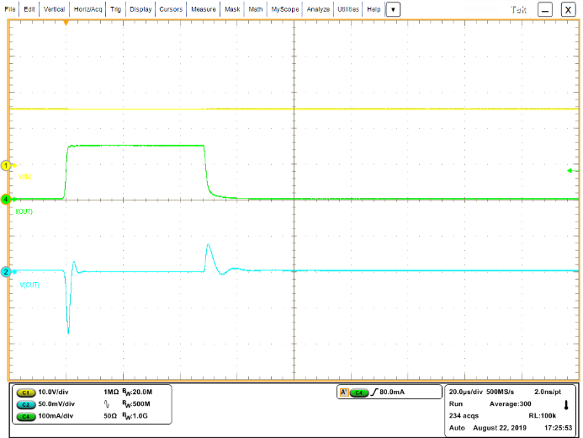
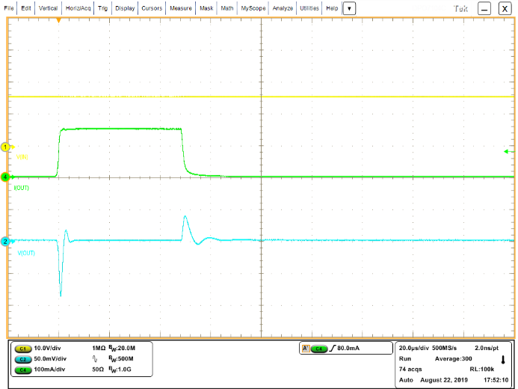
Load transients – Vout=15V
Vin=15.5V,Vout=15V, Iout=1-150mA, tr=tf=1us
Cout=1u
Cout=10u
Cout=22u
Cout=50u
V_{IN}
V_{IN}
V_{IN}
V_{IN}
I_{OUT}
I_{OUT}
I_{OUT}
I_{OUT}
V_{OUT}
V_{OUT}
V_{OUT}
V_{OUT}
-120mV / +70mV
-0.80% / +0.47%
-110mV / +70mV
-0.73% / +0.47%
-100mV / +60mV
-0.66% / +0.40%
-44mV / +28mV
-0.29% / +0.19%
ADJ-15V Cadj1=100p
ADJ-15V Cadj1=1n
V_{IN}
V_{IN}
ADJ-15V, Cout=1uF,
(various C_{ADJ1})
I_{OUT}
I_{OUT}
V_{OUT}
V_{OUT}
-90mV / +40mV
-0.60% / +0.27%
-85mV / +40mV
-0.57% / +0.27%
50mV/div

Slide 15
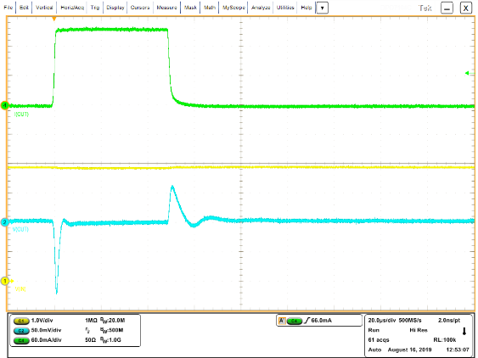
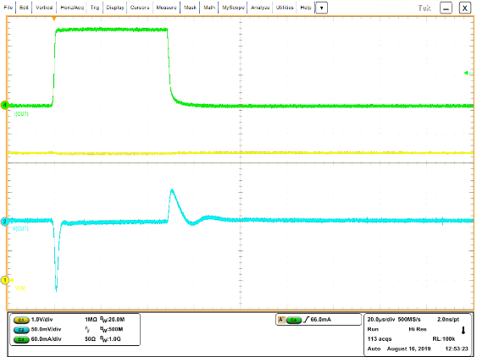
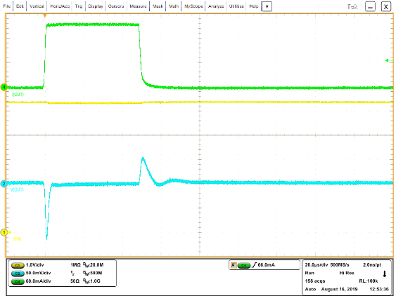
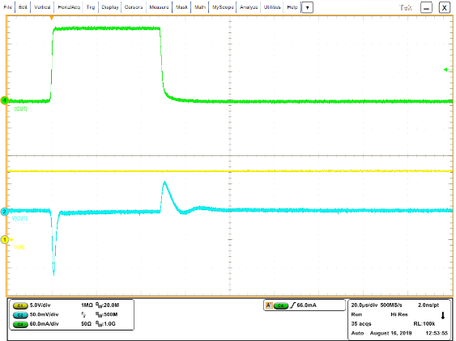
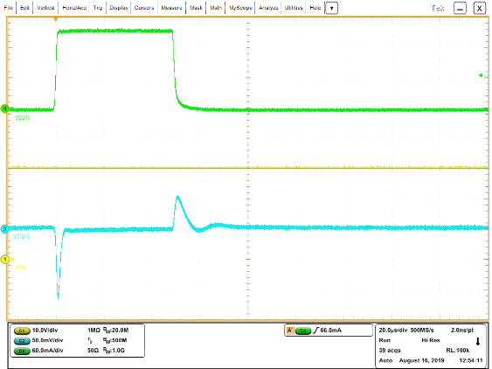
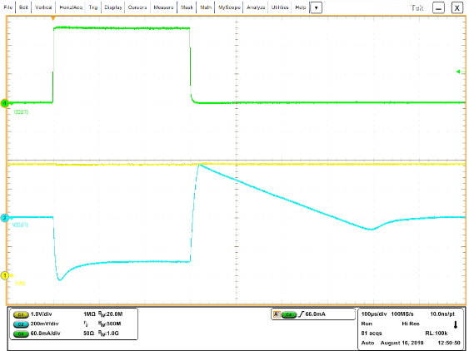
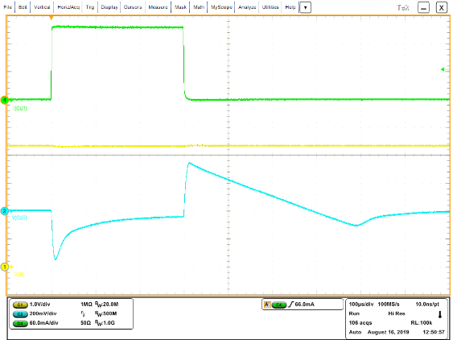
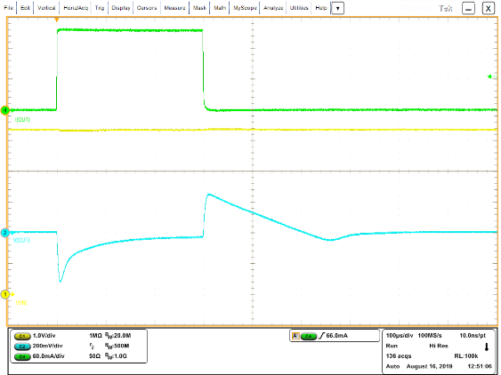
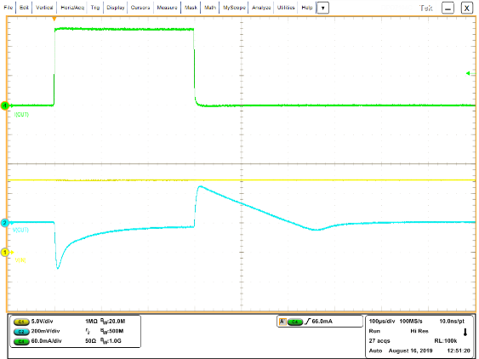

NCP730 vs TPS709 – Single Load Transients zoom of NCP730
Iout=1-150mA, tr=tf=1us – same conditions and NOT the same scale
NCP730 3.3V – Cout=1u (used minimal)
Vin=3.8V
Vin=4.3V
Vin=5.3V
Vin=12V
Vin=24V
-122mV / +65mV
-120mV / +55mV
-115mV / +53mV
-114mV / +52mV
-115mV / +53mV
TPS709 3.3V – Cout=2u (used minimal)
Vin=3.8V
Vin=4.3V
Vin=5.3V
Vin=12V
Vin=24V
Is in dropout here
-435mV / +370mV
-350mV / +350mV
-310mV / +260mV
-310mV / +260mV
-310mV / +270mV
Comments: NCP730 is significantly better than TPS709

Slide 16
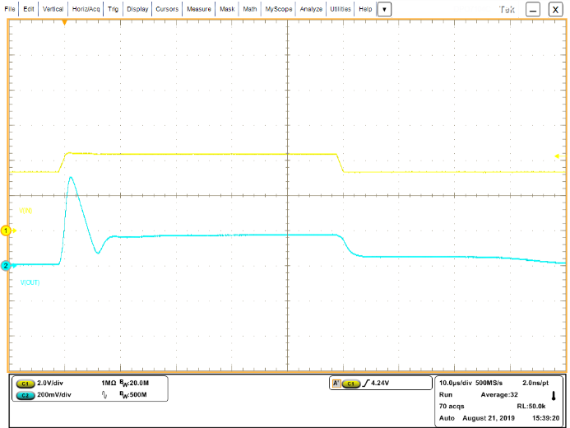
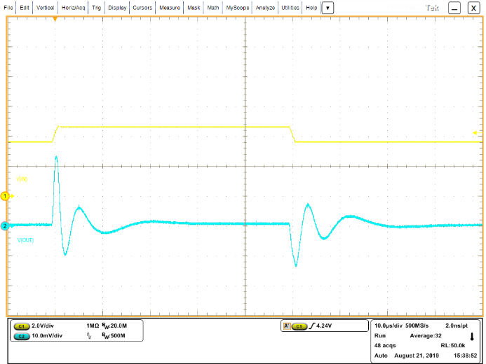
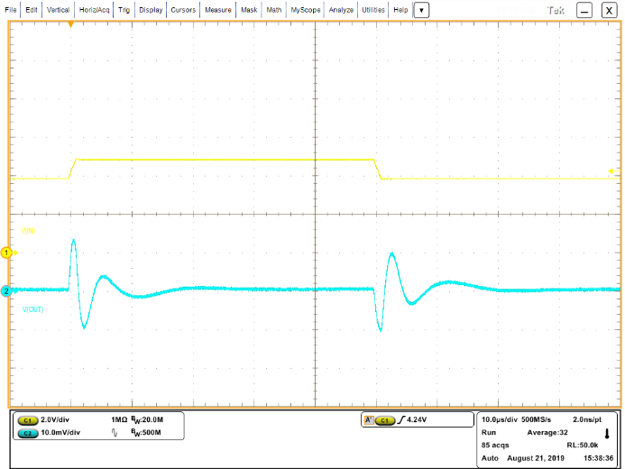
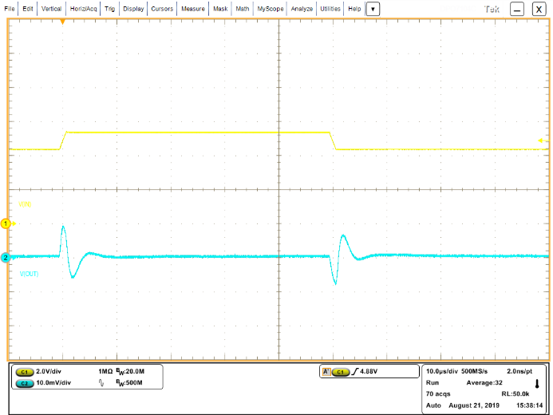
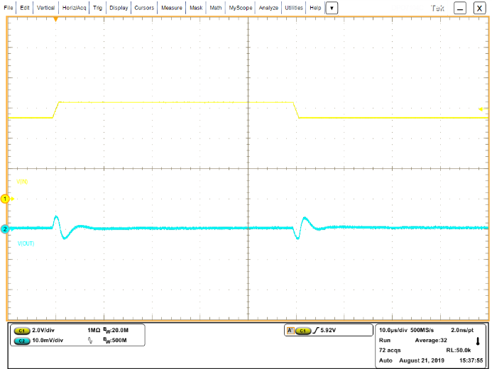
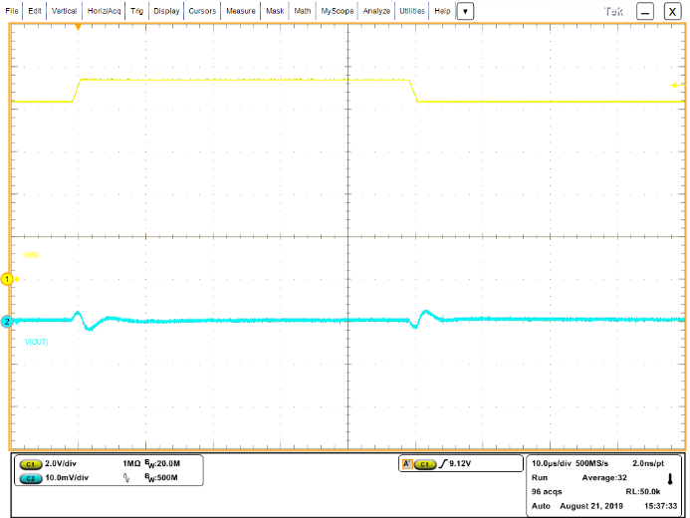
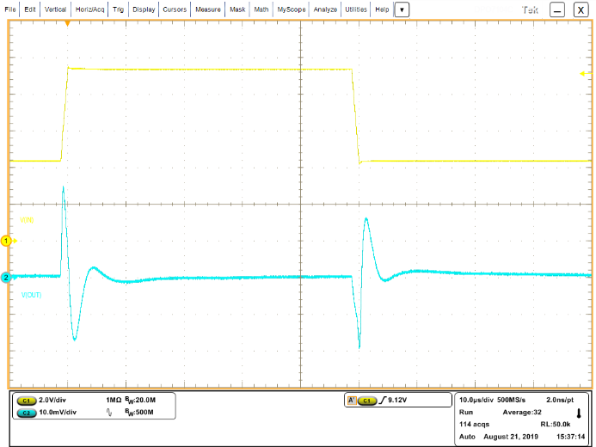
Line transients – NCP730-3V3, C_{OUT}=1uF, I_{OUT}=100mA
tr=tf=1us
Vin=3.3-4.3V
Vin=3.6-4.6V
Vin=3.8-4.8V
Vin=4.3-5.3V
V_{IN}
V_{IN}
V_{IN}
V_{IN}
V_{OUT}
V_{OUT}
V_{OUT}
V_{OUT}
+500mV / -0mV
Note: from dropout to regulation
+24mV / -13mV
+14mV / -10mV
+9.0mV / -7.5mV
Vin=5.3-6.3V
Vin=8.3-9.3V
Vin=4.3-9.3V
V_{IN}
V_{IN}
V_{IN}
V_{OUT}
V_{OUT}
V_{OUT}
+4.0mV / -3.0mV
+2.0mV / -2.0mV
+25mV / -19mV

Slide 17
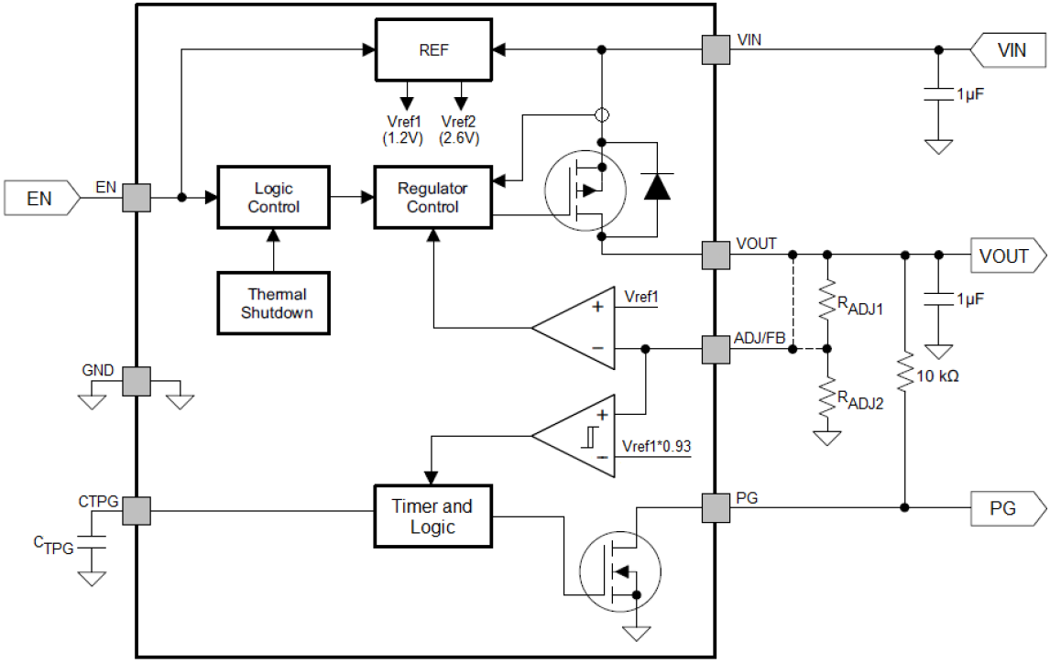
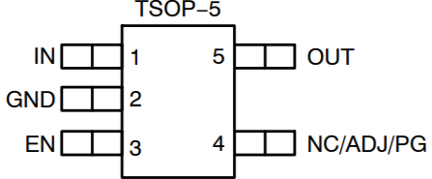
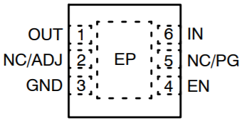
NCP730 – 38V, 150mA, 1uA Iq LDO with Power Good
Value Proposition: Wide-Input Voltage, Low Iq, Low Dropout
The NCP730 is a next generation CMOS LDO regulator designed for up to 38V input voltage and 150mA output current. Designed to meet the requirements for industrial wide-input voltage circuits. The NCP730 device provides ultra−low quiescent current of only 1uA, which makes this device ideal solution for battery powered application. Output voltage can be set from 1.2 to 24V, adjustable or fixed. The device also offer excellent load/line transient regulation and output Power Good function to reset MCU. The device is available in TSOP-5 and WDFN-6 packages.
Unique Features
Benefits
Application Data (WDFN-6)
2.7V to 38V input voltage
Ultra-Low Iq : 1µA typ
Built-in Soft Start Circuit
Power Good function (Ver B)
Can support multi-cell battery application
Extend battery life / save power
Can suppress inrush current to protect IC
Can reset MCU to avoid malfunction
Enable pin. Shutdown current ~100nA
Wide input range
Other Features
Fixed & Adjustable Voltage Options Available: 1.2V to 24V
±1% Accuracy @ Tj : -40 ~ +85ºC
290mV typical dropout @ 150mA of output current, 3.3Vout
Short Circuit Protection, Thermal Shutdown Protection
Stable with 1uF ceramic capacitor
Power Good function for MCU reset
Market & Applications
Ordering & Package Information
Battery-Powered Power Tool and Equipment
Smart Metering, Smoke Detector
Industrial Automation, Home Automation
IT, Home Appliances
Combination Arc-Fault Circuit Breakers (CAFI)
Datasheet: Now
Samples: Now
Release to Production: Now
WDFN-6 (2*2)
19

Slide 18
Thank You

