Slide 1
NCP3237 PC1
Evaluation Board Guide

Slide 2

Schematic
5
4
3
2
1
TRANSIENT LOAD
DNP
DNP
2 1
R1
2 1
R2
J1
D
2PIN 1ROW ₂
2 1
D
BST
TP11
TO SIGN. GEN.
1
10.0K R4
1 2
2.0 R3
NTMS4801
Q1
T1
Vin
TP1
VIN
2
U1
BST
1
BST 2
R5 0.0
1
SW
TP2
PGND
Vout
TP5
VIN
1
+
C4
2 1
C2
2 1
J15
2
J16
2
VIN1
1
C7
TP4
2
C5
C1 C6
22uF 22uF
1
EN
1
11
VIN2
6
0.1uF
100uF
22uF
0.1uF
R6 90.0K
NCP3237
SW1
2
1
L1
1uH
VOUT
T2
TP3
7
SW2
SW
RA1
1
C12
+
C13
1
Vout
EN
17
EN
14
FB
FB
DNP
C8
C9 C10 C11 47uF 47uF 47uF
2
EN
J2
2
R7
1
PG
TP12
COMP ^{TP6}
CA1 DNP
1 2
47uF
2
0.1uF
DNP
1
30.1K
PG
18
PGOOD
15
COMP
COMP
TP8
2
VCC
TP7
R9 100K
1 2
16
3
PGND
2
TP10 _{FB}
NA-
VCC
PGND1
R10 10.0
TP9
C
1
4
PGND2
C17
C18
C
C15
C3
FSET 13
FSET
QFN3535-18L
5
PGND3
R11
NA+
NA+
10uF
2
0.1uF
8
PGND4
R12
1
68pF
C19
1
R27
2
150
680pF
9
2
R13
AGND
12
PGND5
10
0
For NCP3239
2 1
AGND
PGND6
13.7K
1nF
1
20K
J14
HEADER 5X2_5103308-1
R8 0.0
2
1
R26 DNP
For TPS54824
2
1V
^{J5} R14
30K
2
1 2
1.2V
2
1
J6
1
3
5
7
4
6
2
1
R15
1
20K
2
9
8
10
R28 0
1 2 FSET
2oz copper.
The top layer contains the main power traces for VIN, VOUT, and SW. Also on the top layer are majority of the signal traces. The top layer has dedicated ground plane for quiet analog ground that is connected to the main power ground plane at a single point. The internal layer-1 is a large ground plane and also routes signals to test points. The internal layer-2 contains an additional large ground copper area as well as an additional VIN and VOUT copper fill. The bottom layer is another ground plane with two additional traces for the output voltage feedback. The top-side ground traces are connected to the bottom and internal ground planes with multiple vias placed around the board.
1.5V
2
1
^{J7} R16
1
13.3K
2
R29 0
1
2 PG
1.8V
2
1
J9
R19
1
10.0K
2
R30 0
1
2 EN
2.5V
2
1
J11
R21
1
6.32K
2
J3
Vin
FSET
3.3V
2
1
J13
R23
1
4.42K
2
2
D1
1.1M
J8
20K
2
R25
1
2
1 1
2
1
2
1
R18
1
DNP
B
GRN
3 2
R17 511
750K
2
1
J10_{R20}
1
29.4K
2
B
550K
J12
R22
40.2K
2
Q2 2N7002LT1
1 PG
2
1
R24
1
1
DNP
2
The input decoupling capacitors and bootstrap capacitor are all located as close to the IC as possible. Additionally, the voltage set point resistor divider components are kept close to the IC. The voltage divider network ties to the output voltage at the point of regulation. Critical analog circuits such as the voltage set point divider, EN resistor and COMP pin are terminated to the quiet analog ground island on the top layer.
2
A
A
5
4
3
2

Slide 3
BOM
Item | Quantity | Reference | Value | PCB Footprint | MFG P/N | MFG | DESCRIPTION
1 | 1 | CA1 | DNP | SMC0402
2 | 3 | C1,C5,C6 | 22uF | C0805 | C2012X5R1E226M125AC | TDK | CAP CER 22UF 25V X5R 0805
3 | 4 | C2,C3,C7,C12 | 0.1uF | SMC0603 | 06033C104KAT2A | AVX | CAP, SMT, 0603, 0.1uF, 25V, 10%
4 | 1 | C4 | 100uF | MU_10 | A767MU107M1VLAE029 | KEMET | CAP, SMT, MU_10, 100uF, 35V, 20%
5 | 4 | C8,C9,C10,C11 | 47uF | C0805 | GRM21BR61A476ME15L | MURATA | CAP CER 47UF 10V X5R 0805
6 | 1 | C13 | DNP | MU_10 | A767MU107M1VLAE029 | KEMET | CAP, SMT, MU_10, 100uF, 35V, 20%
7 | 1 | C15 | 10uF | C0805 | C2012X5R1A106M085AB | TDK | CAP CER 10UF 10V X5R 0805
8 | 1 | C17 | 68pF | CSMI_0603 | CC0603JRNPO9BN680 | Yageo | CAP CER 68PF 50V C0G/NPO 0603
9 | 1 | C18 | 680pF | CSMI_0603 | 885012206082 | Würth Elektronik | CAP CER 680PF 50V X7R 0603
10 | 1 | C19 | 1nF | CSMI_0603 | GRM1885C1H102JA01D | Murata Electronics | CAP CER 1000PF 50V C0G/NP0 0603
11 | 1 | D1 | GRN | D0805 | LTST-C170GKT | LITE-ON | LED GREEN CLEAR SMD
12 | 14 | J1,J2,J3,J5,J6,J7,J8,J9,J10,J11,J12,J13,J15,J16 | 2PIN 1ROW | JTHI_HDR1R2PS | 10/22/2021 | MOLEX | CONN HEADER VERT 2POS 2.54MM
13 | 1 | J14 | HEADER 5X2_702471051 | 702471051 | 702471051 | Molex | CONN HEADER R/A 10POS 2.54MM
14 | 1 | L1 | 1uH | 7_10X6_50X3_00MM | SPM6550T-1R0M100A | TDK | FIXED IND 1.09UH 14.1A 5.2 MOHM
15 | 1 | Q1 | NTMS4801 | SO8_PTDSON8_SO8FL_COMBO_8MIL | NTMS4801NR2G | ON SEMICONDUCTOR | MOSFET N-CH 30V 7.5A 8-SOIC
16 | 1 | Q2 | 2N7002LT1 | QSMI_SOT23 | 2N7002LT1G | ON SEMICONDUCTOR | MOSFET N-CH 60V 0.115A SOT-23
17 | 1 | RA1 | DNP | SMR0402
18 | 2 | R1,R2 | DNP | RSMI_2512
19 | 1 | R3 | 2 | SMR0603 | ERJ-3GEYJ2R0V | Panasonic | RES SMD 2 OHM 5% 1/10W 0603
20 | 2 | R4,R19 | 10.0K | SMR0603 | CRCW060310K0FKEA | Vishay Dale | RES SMD 10K OHM 1% 1/10W 0603
21 | 2 | R5,R8 | 0 | SMR0603 | CRCW06030000ZSTB | DALE | RES, SMT, 0603, 0, 1/16W, 5%
22 | 1 | R6 | 90.0K | SMR0603 | PATT0603E8982BGT1 | Vishay Thin Film | RES SMD 89.8KOHM 0.1% 0.15W 0603
23 | 1 | R7 | 30.1K | SMR0603 | CRCW060330K1FKEA | DALE | RES, SMT, 0603,30.1K, 1/10W, 1%
24 | 1 | R9 | 100K | SMR0603 | CRCW0603100KFKEA | Vishay Dale | RES SMD 100K OHM 1% 1/10W 0603
25 | 1 | R10 | 10 | SMR0603 | CRCW060310R0FKEA | Vishay Dale | RES, SMT, 0603, 10.0, 1/10W, 1%
26 | 1 | R11 | 150 | SMR0603 | CRCW0603150RFKEA | Vishay Dale | RES SMD 150 OHM 1% 1/10W 0603
27 | 1 | R12 | 13.7K | SMR0603 | CRCW060313K7FKEA | Vishay Dale | RES SMD 13.7K OHM 1% 1/10W 0603
28 | 3 | R13,R15,R18 | 20K | SMR0603 | CRCW060320K0FKEA | Vishay Dale | RES 20K OHM 1% 1/10W 0603
29 | 1 | R14 | 30K | SMR0603 | CRCW060330K0FKEA | Vishay Dale | RES SMD 30K OHM 1% 1/10W 0603
30 | 1 | R16 | 13.3K | SMR0603 | CRCW060313K3FKEB | Vishay Dale | RES SMD 13.3K OHM 1% 1/10W 0603
31 | 1 | R17 | 511 | SMR0603 | CRCW0603511RFKEB | Vishay Dale | RES, SMT, 0603, 511, 1/10W, 1%
32 | 1 | R20 | 29.4K | SMR0603 | CRCW060329K4FKEA | Vishay Dale | RES SMD 29.4K OHM 1% 1/10W 0603
33 | 1 | R21 | 6.32K | SMR0603 | CRCW06036K34FKEA | Vishay Dale | RES SMD 6.34K OHM 1% 1/10W 0603
34 | 1 | R22 | 40.2K | SMR0603 | CRCW060340K2FKEA | Vishay Dale | RES SMD 40.2K OHM 1% 1/10W 0603
35 | 1 | R23 | 4.42K | SMR0603 | CRCW06034K42FKEA | DALE | RES SMD 4.42K OHM 1% 1/10W 0603
36 | 3 | R24,R25,R26 | DNP | SMR0603 | - | -
37 | 4 | R27,R28,R29,R30 | 0 | SMR0603 | CRCW06030000ZSTB | DALE | RES, SMT, 0603, 0, 1/16W, 5%
38 | 12 | TP1,TP2,TP3,TP4,TP5,TP6,TP7,TP8,TP9,TP10,TP11,TP12 | TP | TPTHI_100R76 | 2305-2-00-01-00-00-07-0 | MILL-MAX | TESTPOINT, TH, 100R76, TERMINAL, TURRET
39 | 2 | T1,T2 | 2PIN/TERM BLK | TERM_BL_2PS | 39889-0042 | Molex | CON, TH, 2PIN, TERMINAL BLOCK
40 | 1 | U1 | NCP3237 | NCP3239 | NCP3237 | ON SEMI
41 | 1 | NCP3237_EVB_REVB_PCB | 305-PD-20-0313

Slide 4
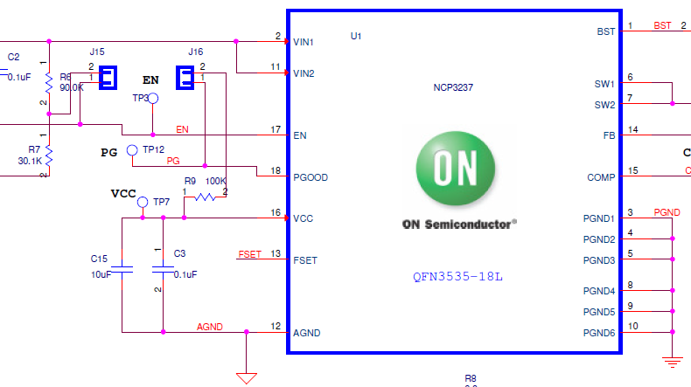
Enable and PGOOD
To enable with Vin divider, connect jumper to J15
To have PGOOD pull-up to VCC, connect jumper to J16

Slide 5
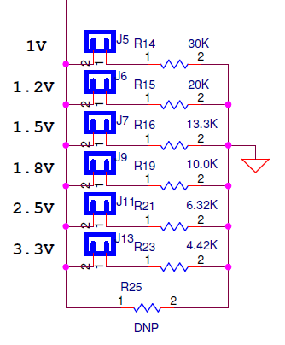
Vout Select
Select output voltage by connecting the corresponding jumper
J5 for Vout = 1V
J6 for Vout = 1.2V
J7 for Vout = 1.5V
J9 for Vout = 1.8V
J11 for Vout = 2.5V
J13 for Vout = 3.3V

Slide 6
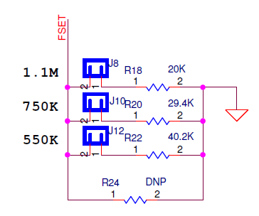
Switching Frequency Select
Select switching frequency by connecting the corresponding jumper
J8 for Fsw = 1.1MHz
J10 for Fsw = 750kHz
J12 for Fsw = 550kHz

Slide 7
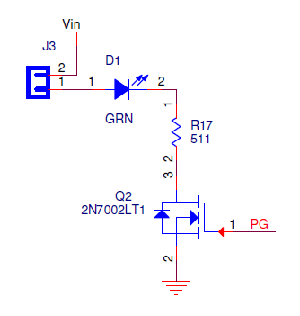
Optional on Indicator LED
To add the optional indicator LED for when the part is on, connect jumper to J3

Slide 8
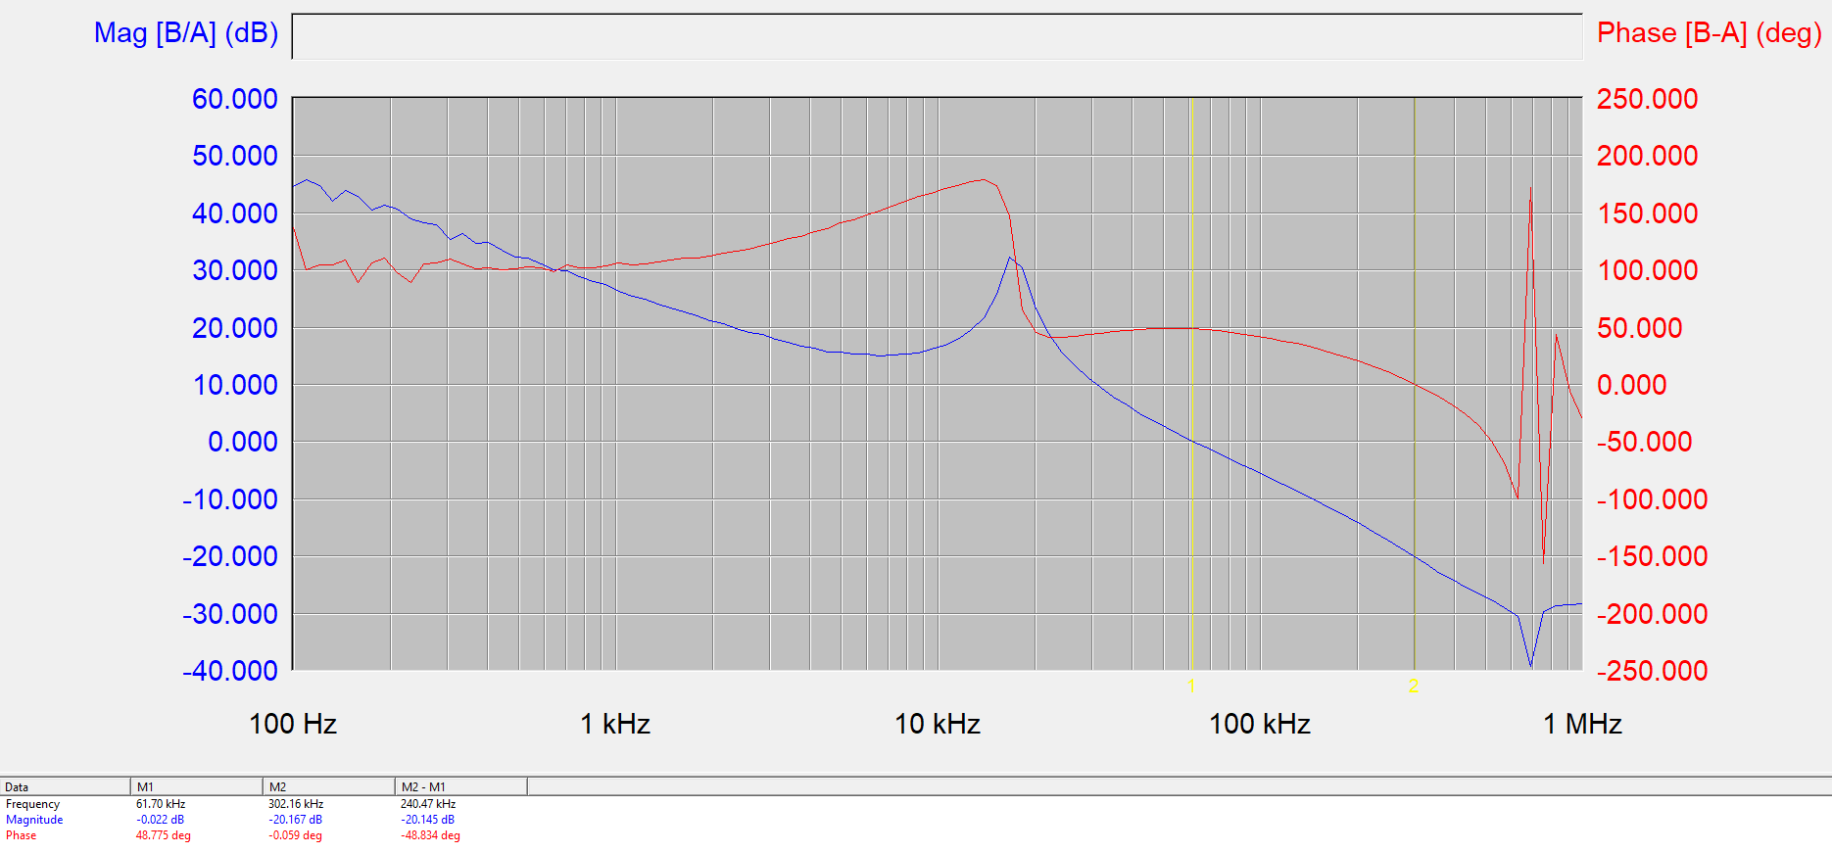
EVB Comp Loop
Bode 12Vin, 1.8Vout, Fsw=550kHz, 8A
PM=49 deg, GM=20 dB, BW=61.7kHz

Slide 9
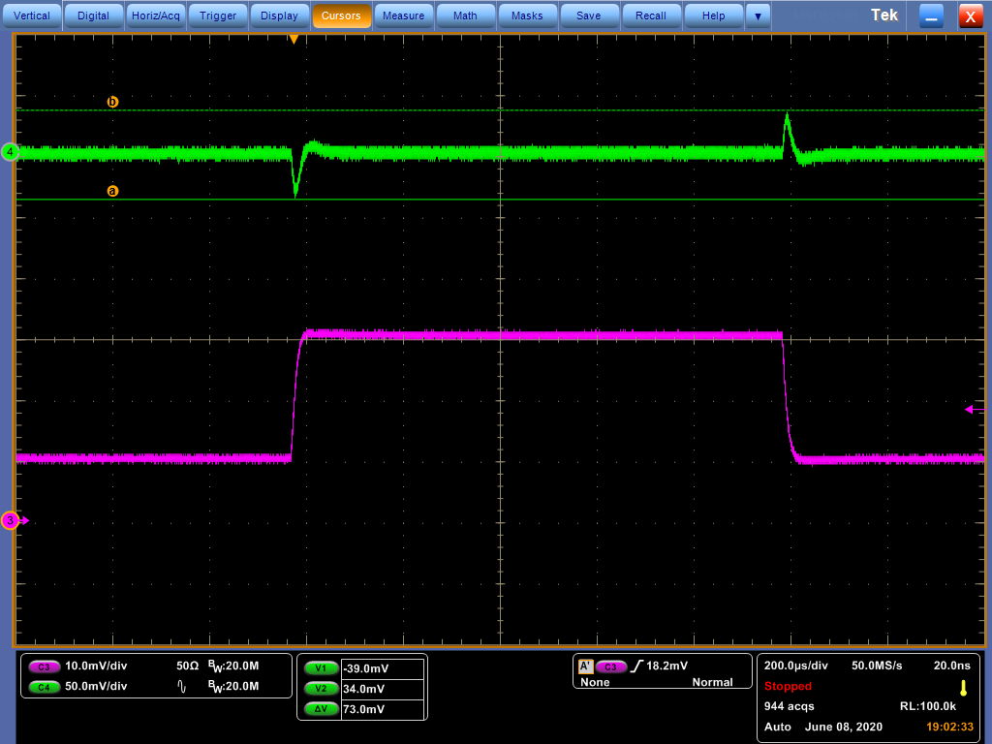
EVB Comp Loop
Load Transient Response
1.8Vout, 550kHz. 2 to 4A step

